Slide 1
Mirror images help us to talk and write back to stories
Werner Stijnen – Thomas More – Campus Vorselaar

Slide 2
Mirror images … get us talking and writing
Do you remember your first visits to your local library?

Slide 3
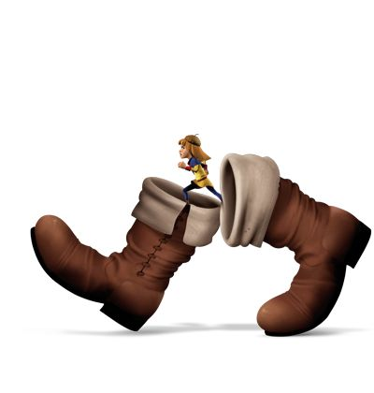
Mirror images … get us talking and writing
Can you picture the place?
What was it like?
How old were you?
Who was there with you?
How did you choose your books?
(Please share quickly! )

Slide 4
Mirror images … get us talking and writing
My story…

Slide 5
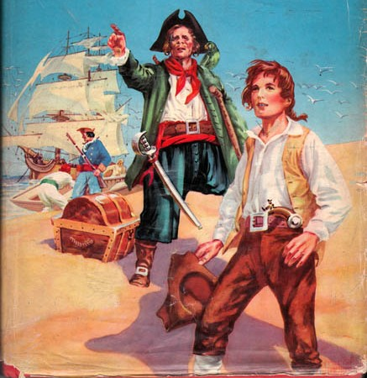
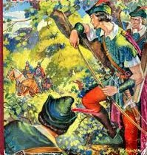
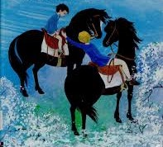
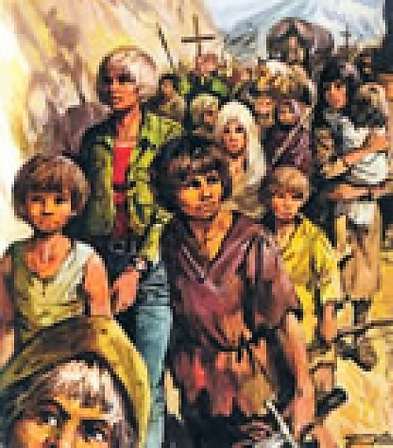
Mirror images … get us talking and writing
My pick of the crop – do you recognise them?

Slide 6
Mirror images … get us talking and writing
The magic combination of this new world of words on paper and a more familiar world of pictures
Then: pictures > reading
This workshop > reading > visual respons > speaking and writing
Reflecting the self and the narrative world

Slide 7
Mirror images … get us talking and writing
Preliminaries
My context = TEFL – secondary education years 1-4
Bringing activities from primary into secondary education
Literature in the classroom - Carter and Long (1991) – Hall (2005)
Cultural model
Language model
Personal-growth model
This is not research-, rather experience-based / some practical suggestions for classroom practice

Slide 8
Mirror images … get us talking and writing
Preliminaries
One research paper I would like to cite:
“Reading Stories Activates Neural Representations of Visual and Motor Experiences” (2009) Speer, Reynolds, Swallow and Zacks - Psychological Science, Vol 20, issue 8, August 2009
Abstract
To understand and remember stories, readers integrate their knowledge of the world with information in the text. Here we present functional neuroimaging evidence that neural systems track changes in the situation described by a story. Different brain regions track different aspects of a story, such as a character’s physical location or current goals. Some of these regions mirror those involved when people perform, imagine, or observe similar real-world activities. These results support the view that readers understand a story by simulating the events in the story world and updating their simulation when features of that world change.
https://www.ncbi.nlm.nih.gov/pmc/articles/PMC2819196/

Slide 9
Mirror images … get us talking and writing
Abstract
To understand and remember stories, readers integrate their knowledge of the world with information in the text. Here we present functional neuroimaging evidence that neural systems track changes in the situation described by a story. Different brain regions track different aspects of a story, such as a character’s physical location or current goals. Some of these regions mirror those involved when people perform, imagine, or observe similar real-world activities. These results support the view that readers understand a story by simulating the events in the story world and updating their simulation when features of that world change.
https://www.ncbi.nlm.nih.gov/pmc/articles/PMC2819196/

Slide 10
Mirror images … get us talking and writing
Let’s collect some techniques (materials) to give visual reactions to stories first:
Can you name some?

Slide 11
Mirror images … get us talking and writing
Let’s collect some techniques to give visual reactions to stories first:
drawing / painting techniques
collage and arts&crafts
photographs and film (fragments)
dramatic expression
images of digital design

Slide 12
Mirror images … get us talking and writing
Let’s pick a few for each technique…

Slide 13
Mirror images … get us talking and writing
Drawing
send a postcard from
your story

Slide 14
Mirror images … get us talking and writing
Drawing
draw a character
picture a landscape

Slide 15
Mirror images … get us talking and writing
Arts&crafts – ‘cereal box’

Slide 16
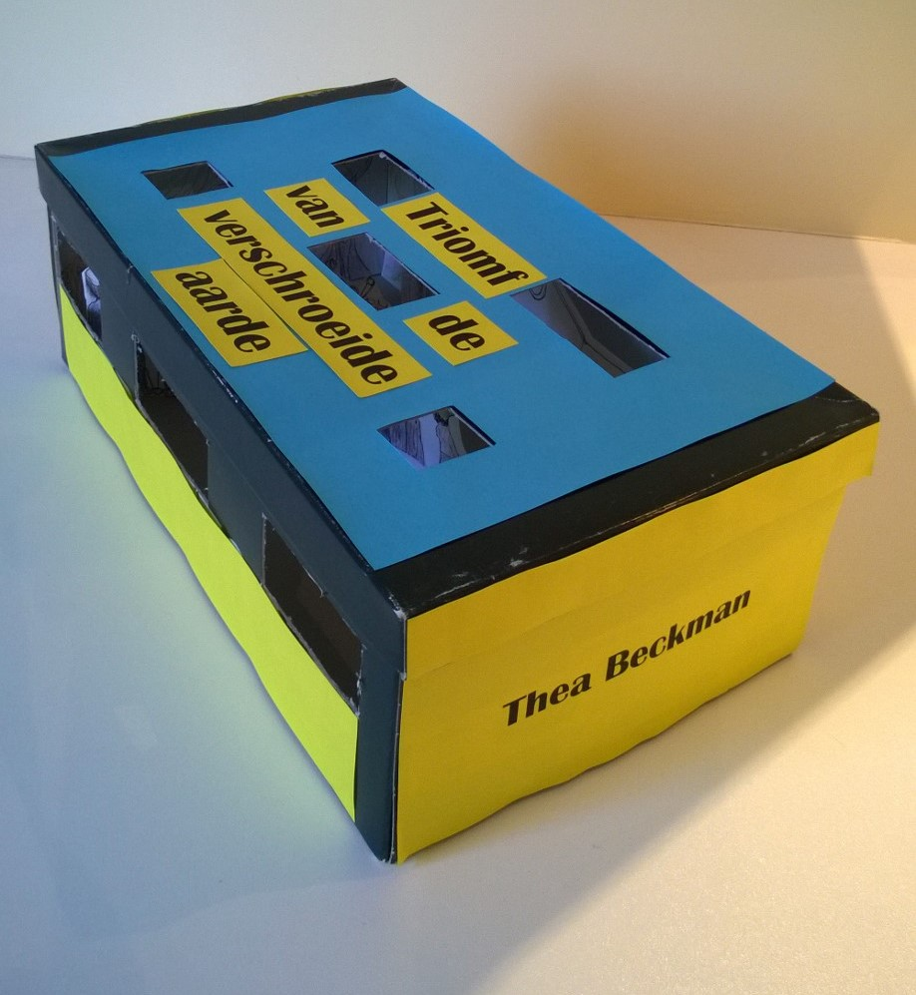
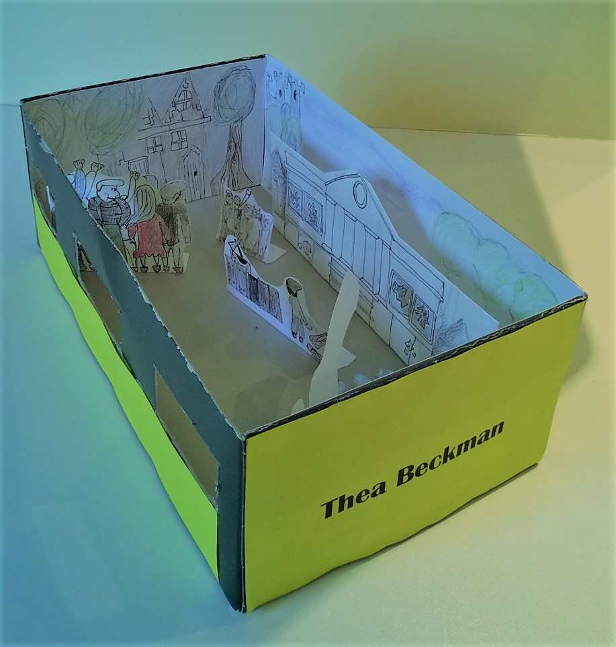
Mirror images … get us talking and writing
Arts&crafts – the ‘viewing box – picture a scene’

Slide 17
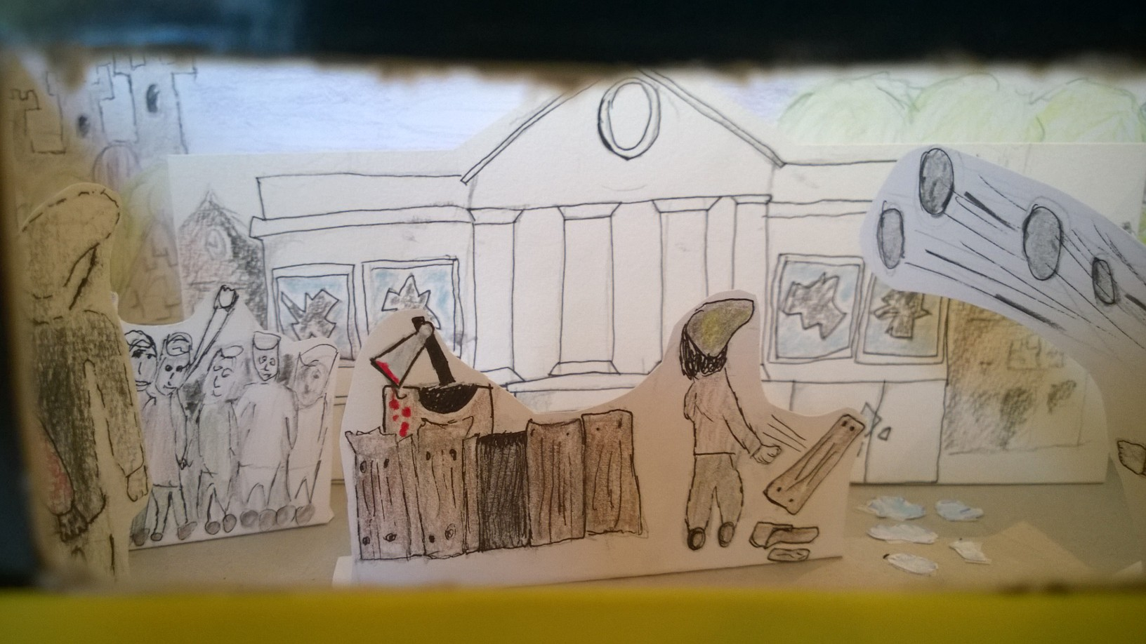
Mirror images … get us talking and writing
Arts&crafts – the ‘viewing box – picture a scene’

Slide 18
Mirror images … get us talking and writing
Arts&Crafts – fashion – design your ‘Story T-shirt’

Slide 19
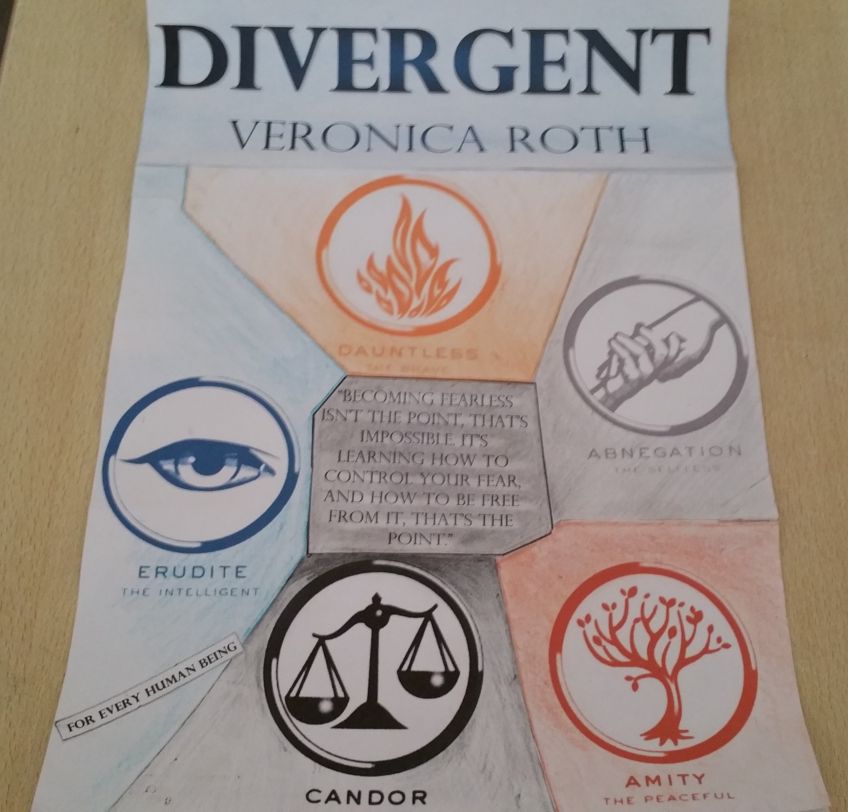
Mirror images … get us talking and writing
Collage or picture boards

Slide 20
Mirror images … get us talking and writing
Collage or digital images:
mood-boards
‘Ragtime’
E.L.Doctorow

Slide 21
Mirror images … get us talking and writing
Film - book trailer:

Slide 22
Mirror images … get us talking and writing
Dramatic expression – acting out a scene / tableau

Slide 23
Mirror images … get us talking and writing
Dramatic expression – your own puppet theatre

Slide 24
Mirror images … get us talking and writing
Digital images - emoji chains
Express yourself…

Slide 25
Mirror images … get us talking and writing
Digital images –
create a digital image
(e.g. book cover)

Slide 26
Mirror images … get us talking and writing
Picture boards

Slide 27
Mirror images … get us talking and writing
Digital response -
Google maps itinerary / street view travel to location

Slide 28
Mirror images … get us talking and writing
Augmented reality
a world of layers
(sound – text – pictures – webpages)
over your ‘trigger’ object or picture
(via smartphone or tablet)

Slide 29
Mirror images … get us talking and writing
Augmented reality

Slide 30
Mirror images … get us talking and writing
Other ways of responding:
Make a bubble network with pictures
Create a Facebook page for a character
Take Snapchat pictures and captions
Take selfies - facial expressions / tableaux vivants
Design a magazine (cover) for your story

Slide 31
Mirror images … get us talking and writing
Your top-3 have done/will do - compare your lists?
send a postcard - draw a character / landscape
comic/storyboard - ‘cereal box’ book report
‘shoe box scene’ - collage and mood-boards
story T-shirt - matching photograph/film scene
film trailer - expressive mode-drama/tableau/puppets
Emoji chains - digital story cover
Facebook page - Snapchat exchange
Selfies - story magazine cover

Slide 32
Mirror images … get us talking and writing
Content of responses
Descriptive and (interpretative) (narrative world)
Describing and interpreting setting, events and plot, characters, theme, …
Expressive (appreciative) and affective (reader)
Expression of reader’s emotions
Expression of appreciation
Expression of ‘otherness’ (personal situation – fictional world) / intercultural learning

Slide 33
Mirror images … get us talking and writing
Possible positive effects of visual responses:
‘Lowers the threshold’ of respons and involves the readers;
Caters for different ways of reacting and learning;
Can work for all age groups (depending on visual reaction);
Postpones ‘verbal’ and more explicit interpretation (dancing with images);
Allows for direct comparison and confrontation with other images;
Allows for intercultural / diversity-aware learning.

Slide 34
Mirror images … get us talking and writing
Mind out for:
You needn’t use a visual response-(‘means’, not ‘end’☺)!
Some visual responses can be very time-consuming (and they are not really language focused).
The short-cut from visual reaction to language production may result in limited time for the reading experience.
The (personal) visual reactions may cause interference with quality interpretations of the narrative.

Slide 35
Mirror images … get us talking and writing
However, from a TEFL point of view:
The learners have just created their personal prop for speaking or writing (TEFL)

Slide 36
Mirror images … get us talking and writing
Some possible language responses are in line with what we already have as pictures:
Emojis > send a text message to a character
Pinterest/Snapchat > write caption texts with the pictures
Postcard / ‘holiday greetings’ from your book on the back
Google maps / report ‘Live’ from a place in the book or write a travel blog
Augmented reality > ‘auras’ can be textual (spoken or written)

Slide 37
Mirror images … get us talking and writing
Other ways of writing or talking back to stories
Write an e-mail or a letter to a character / author
Write the backstory of a context / a character
Write a blog about the story / reading experience
Make a vlog about the story / reading experience
Send a video message to a character

Slide 38
Mirror images … get us talking and writing
Final thoughts,
in mirror images we reflect ourselves, our stories and the stories we read …
one picture to trigger a thousand words…
Let’s talk about it!

Slide 39
Mirror images … get us talking and writing
To work…
contemporary stories from Syria
Story 53 from ‘Breaking Knees’
by Zakaria Tamer

Slide 40
Mirror images … get us talking and writing
Visual responses:
Find a film scene that this story makes you think of:

Slide 41
Mirror images … get us talking and writing
Visual responses:
Find a film scene that this story makes you think of:
Episodes of ‘Annoying Orange’

Slide 42
Mirror images … get us talking and writing
Respons 2:
Find a book cover of a story that this story makes you think of:

Slide 43
Mirror images … get us talking and writing
Respons 2:

Slide 44
Mirror images … get us talking and writing
Respons 3:
Find a picture/ painting with one of the arguments the apples use and put this as an ‘aura’ over your copy of the story:

Slide 45
Mirror images … get us talking and writing
Respons 3:
Find a picture/ painting with one of the arguments the apples use:

Slide 46
Mirror images … get us talking and writing
Can you come up with language activities as a follow-up to one of the previous ‘visual responses’?

Slide 47
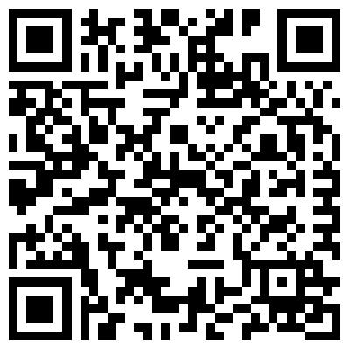
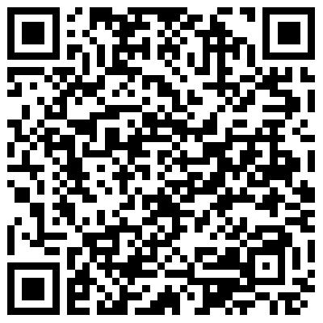
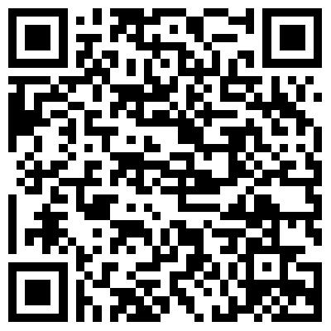
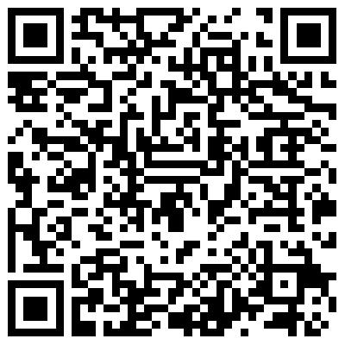
Mirror images … get us talking and writing
Alternative book reports – pair up and choose 2 from your list!

Slide 48
Mirror images … get us talking and writing
Alternative book reports
OR browser search terms
Ncte.org – resources – book reports
Scholastic book report alternatives
Teachnet more ideas than ever book reports
Readwritethink fifty alternatives book report

Slide 49
Mirror images … get us talking and writing
Alternative book reports
http://www.ncte.org/library/NCTEFiles/Resources/Journals/EJ/0871-jan98/EJ0871Ideas.PDF
https://www.scholastic.com/teachers/articles/teaching-content/classroom-activities-25-book-report-alternatives/
http://teachnet.com/lessonplans/language-arts/more-ideas-than-ever-book-reports/
http://www.readwritethink.org/professional-development/professional-library/fifty-alternatives-book-report-30452.html

Slide 50
Mirror images … get us talking and writing
Let’s take them (boots) off…
Thanks!
Werner

