Slide 1
Intercultural learning and using texts in classrooms
Jlau
Mechelen 2017

Slide 2
Why use literary texts in Language classrooms?
we use literary texts to include the following aspects
The Cultural Aspect: learning about another culture, ways of thinking, feelings, attitudes, etc. Becoming aware…
The Language Aspect: as linguistic input, authentic language input, with creative uses of the language
The Personal Aspect: in identifying with and understanding other human beings and experience the world through their perspectives

Slide 3
From the Danish Curriculum for English (EFL)
Intercultural Contact
Students establish an intercultural competence while studying English. For some students, English is their first foreign language and first entry into another culture other than what is known from home.
Students build an understanding of the English language cultures and societies and the relationship between language and culture. This may be done through focusing on children’s daily life and traditions. The choice of imagery and other texts is on the basis of their cultural significance.
Later, students gain their first insight into daily life and values in their own and in the English-speaking cultures and regions. They develop their awareness of the relationship between language, culture and self-understanding. Stories and tales from children’s daily lives will be used

Slide 4
Intercultural understanding
With children
The intercultural understanding: begin to get an understanding of the other…
The ideas of who am I, and who are you? (Byram)
What is different and what is the same?
“How can I understand someone who seems different from me?”
Decentering yourself - meeting the other one!

Slide 5
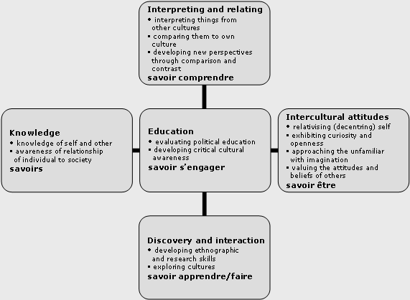
Intercultural competence (M. Byram)

Slide 6
Dimensions in intercultural competence
The cognitive dimension (gaining knowledge – getting to know about)
The behaviourial dimension (what do people do, traditions, actions)
The affective dimension ( feelings, attitudes, values) – promoting empathy

Slide 7
Using Authentic books for learning:
Picture books or other books for children
Authentic language input – and the authentic language being rich, idiomatic, varied
The language has already been adapted to children (but native speakers)
Learning through pictures AND words
Visual support for learning the language
Being exposed to many constructions of meaning
The pleasure of stories
The unique potential, and the amusing, witty, fun stories

Slide 8
Topics for the young learners
Food,
play,
school,
Home
everyday actions for children
IN the intercultural perspective: meeting the other one at this everyday level
Literature can provide this input

Slide 9
Decentering: Who am I and Who are you?
- Getting to know the diversity of children who live in the same country
- Getting the stories of their every day lives told:
About:
where they live, where they come from
what they love – food, hobbies, etc
what they do ,
who their families are and friends, what school is like…

Slide 10
”We Are Britain”
By Benjamin Zephaniah
Who are you?
- IN fact (statements , descriptions)
- AS poetry
How to turn the ”fact files” into poetry – and what is the effect?

Slide 11
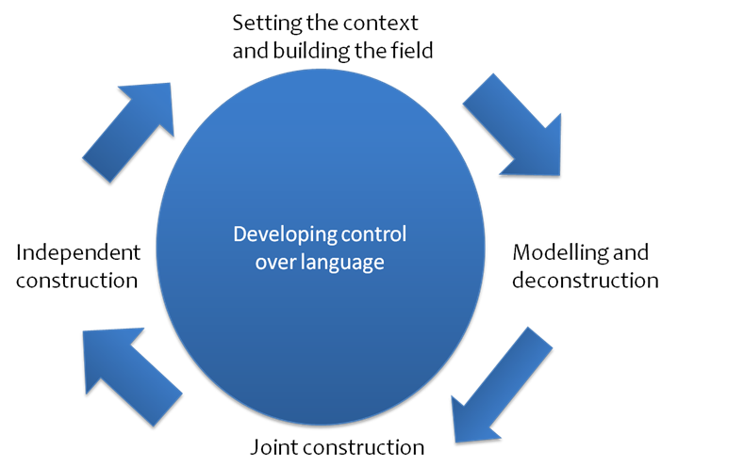
Teaching – learning - cycle

Slide 13
Sam’s story: the economy flyer
Pre-reading: Looking at the pictures
Reading the fact file first (preparing for the poem): focus on comprehension: giving names of places, the hobby.
Reading the poem out loud next: and talk about:
- make the children choose a line each to read out loud
- look at the patterns of the poem
And then talk about
- what do we know about Sam’s life now?
- what about the title of the poem?
What s the effect of the reading/listening to the poem – compared to the fact file?

Slide 14
Choose one of the stories and then write
- Plan how you want to work with this child’s story
Now your class
- let the children bring some photos
- Let the children write – or tell – five things about themselves
- then help them turn these into a poem about themselves

Slide 15
LIterature
Zephaniah, Benjamin, “We are Britain”, Frances Lincoln, 2003
Birketveit, Anna, (2013) Picturebooks, in Literature for the English Classroom, Theory into practice (pp. 17-53)
Collie, J and Slater, S., (1987) Literature in the Language Classroom, Cambridge UP
Hunt, Peter (2005), Understanding Children’s Literature, 2nd edition, London: Routledge
Nikolajeva, Maria (1996) Children's literature comes of age. Toward a new aesthetic. Garland

Slide 16
And more
Byram, M. et al (2002): Developing the intercultural dimension in language teaching, Council of Europe
Hofstede, Geert, (2006) Cultures and organisations, at: http://geerthofstede.com/index.aspx
Koutsompou, Violetta-Irene, (2015), “The Use of Literature , Methods and Aims,” in International Journal of Information and Education Technology, Vol. 5, No. 1, January 2015
Risager, Karen (2000), ”The teacher’s intercultural competence,” in Sprogforum, vol. 6, no. 18, University of Aarhus.

