Slide 1
Stories living on today: customs, traditions, places, monuments
Continuity and changes
Values and competences

Slide 2
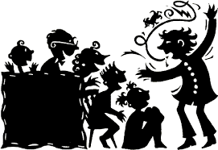
‘There have been great societies that did not use the wheel, but there have been no societies that did not tell stories’
Ursula K. Le Guin

Slide 3
‘Story causes us to tap into the universal situations of life, to stand in the shoes of others in all the world’s past, present and future, taking risks, suffering, sorrowing, laughing, wondering, challenging, feeling satisfied but, most of all, tuning into the archetypes of all story wisdom.’
Barton & Booth – Stories in the classroom

Slide 4
Universal - unique
‘Universel singulier’ (Hegel)
otherness – self
here – there
now – then

Slide 5
Stories
coming from the past
still alive today
linked to places / customs and traditions
told here and there

Slide 6
Tales and legends
Convey values
Answer questions (e.g. origins)
Depict heroes’ lives – symbols
Same characters in different times and places (with different features)
Give some information about specific cultures
Saints’ lives gave birth to different customs: St Nicholas – St Martin – St Patrick

Slide 7
Characters – archetypes
- little people
- dragons
- kings, princes, princesses
- poor people
- wicked people
- good people

Slide 8
Dragon
Any story you know?
Characteristics?
In your country, in your place?

Slide 9
St George and the dragon
Have you heard about this legend?
What do you associate with it, with Saint George?

Slide 10
Saint George and the dragon
Paolo Uccello
Saint George and the dragon
About 1470

Slide 11
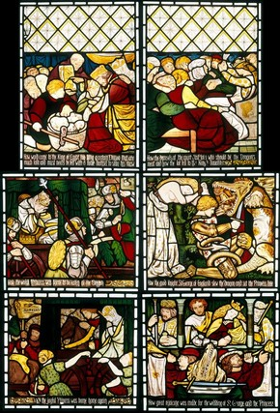
Saint George and the dragon
Gabriel Dante Rossetti
Saint George slaying the dragon
Stained glass window
About 1862

Slide 12
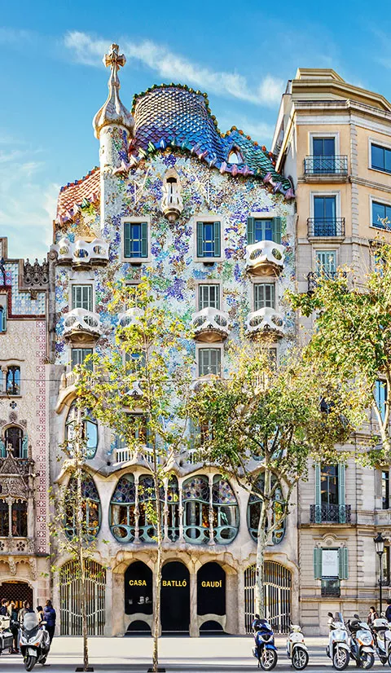
Saint George and the dragon
Barcelona
https://www.casabatllo.es/en/saint-georges-day/

Slide 13
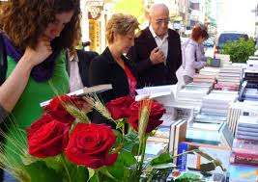
Saint George and the dragon
Barcelona

Slide 14
Saint George and the dragon
Mons (B) – UNESCO – Intangible cultural heritage

Slide 15
Saint George and the dragon

Slide 16
Saint George and the dragon

Slide 17
Saint George and the dragon

Slide 18
Saint George and the dragon

Slide 19
Drachenstich – Fürth im Wald (D)

Slide 20
Cracow – Wawel dragon
Metal sculpture
By Bronislaw Cromy
In front of the dragon’s den
The dragon has 7 heads and noisily breathes fire every few minutes.

Slide 21
Saint George and the dragon in modern children literature

Slide 22
Saint George and the dragon in modern children literature
Changes
Good vs. Bad
Characteristics
Appearance
Setting
Lifestyle
Humour

Slide 23
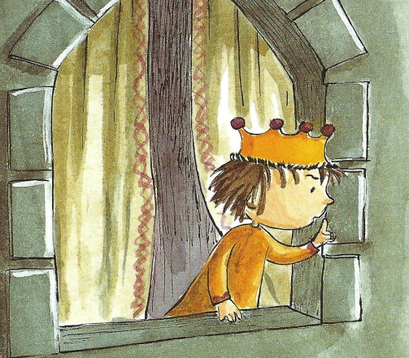
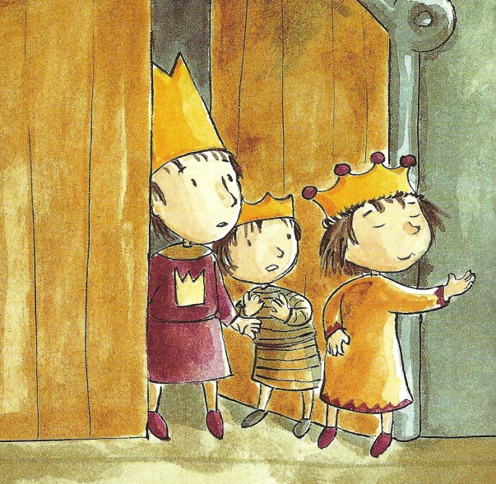
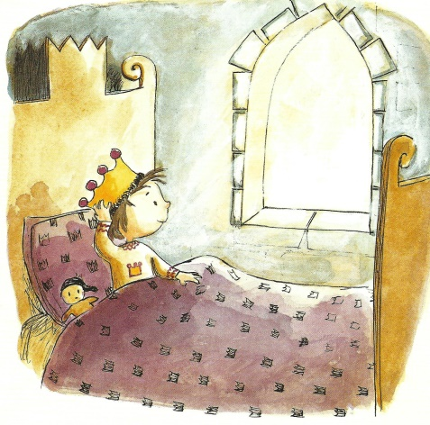
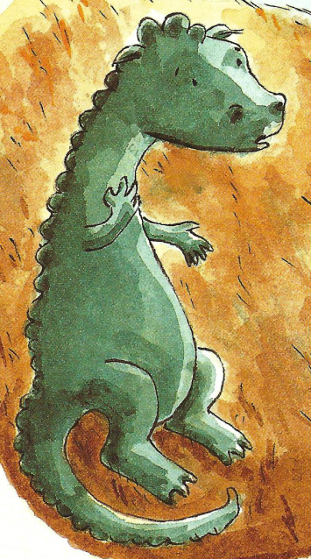
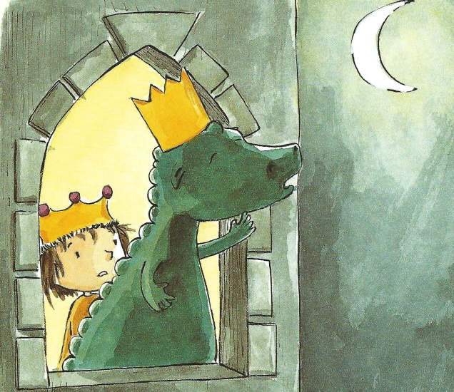
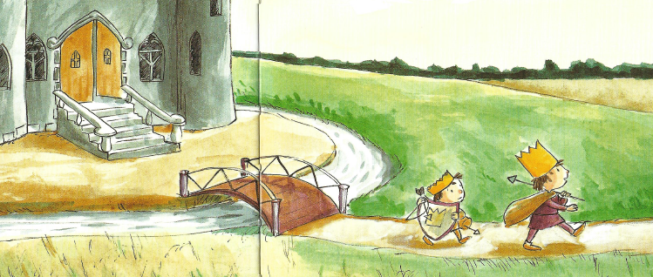
Minisaga – 50 words

Slide 24
Stories and traditions - places / monuments
Antwerp – Brabo
Brussels – Manneken Pis
Namur & Dinant – 4 Aymon sons
Orval – The Mathilde fountain
Mechelen – Maneblussers – Moon extinguishers
Liège – Tchantchès

Slide 25
Namur – the stilters

Slide 26
Namur – the stilters

Slide 27
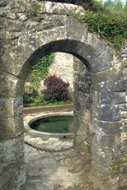
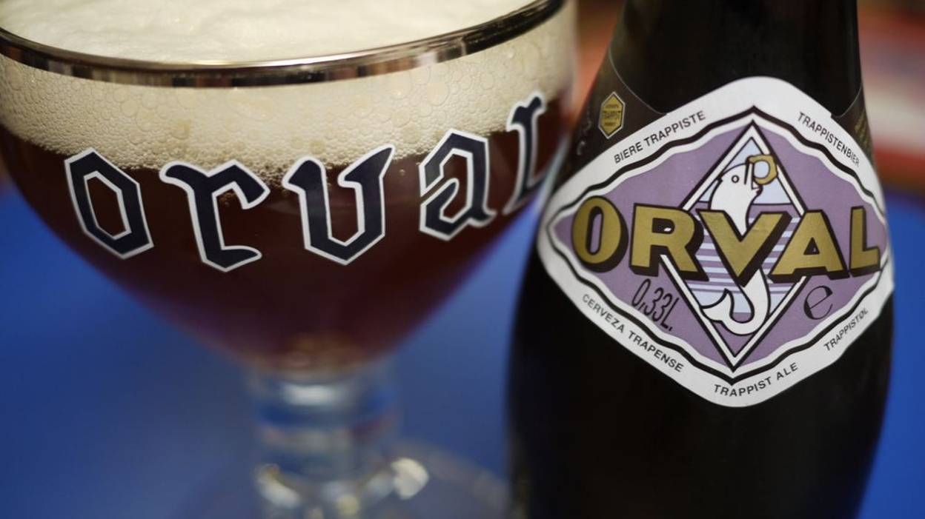

Slide 29
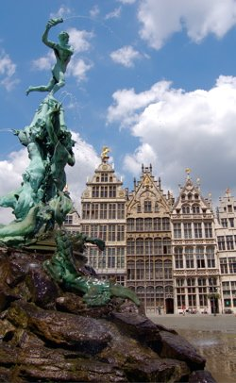

Slide 30
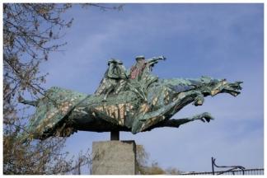

Slide 31
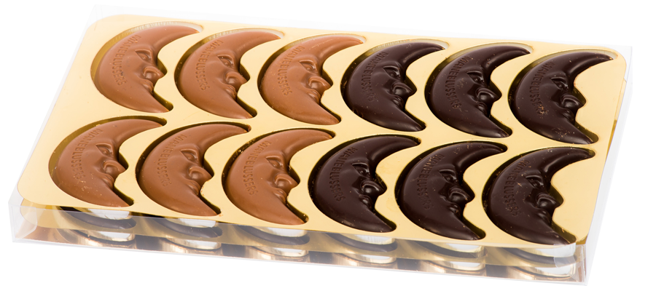

Slide 32
What about your place?
What about your country?
Do you know any other tale / story like these?

Slide 34
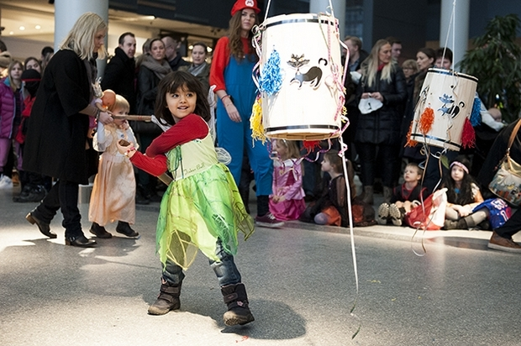
Fastelavn - Denmark
Notes:
Fastelavn is an old tradition going back to the Pagan days, where you actually put a live cat in barrel and then hit the barrel to find a ‘Cat King’ and ‘Cat Queen’. People used to believe that the plague could be avoided if a black cat was killed, so therefore a black cat was always chosen.
Today, the tradition is much more cat-friendly and mostly for children who dress up in costumes. The barrel of today is filled with candy and is often painted in various colours and children line up to hit it with a bat. The first child who knocks out the bottom is made ‘Cat Queen’ while the one who knocks down the last board is made ‘Cat King’.

Slide 35
Bonfire night

Slide 36
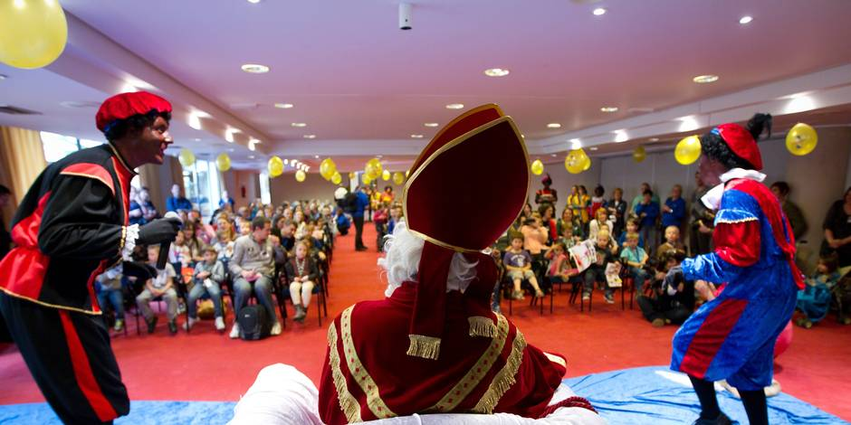
St Nicholas’ day

Slide 37
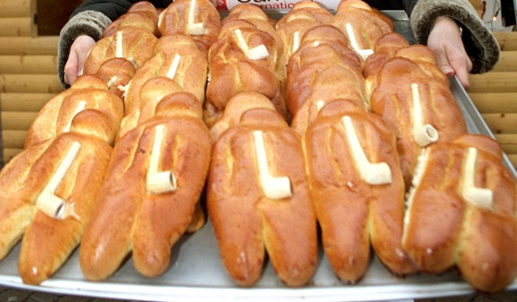
St Martin’s day

Slide 38
‘After nourishment, shelter and companionship, stories are the thing we need most in the world’
Philip Pullman

Slide 39
Thank you!
Enjoy stories and share this joy!

