Slide 1
Task 1 – enquiry case study topical or extreme weather event
Review the climate enquiry as a scheme of work/sequence of learning
http://www.collaborativelearning.org/11coordinator.pdf
Refer to GA Assessment and progression framework for geography
http://www.collaborativelearning.org/18assessment.pdf
In your groups – select a segment & think through responses to the set of ‘deep dive’ questions on the next slide.
You will be feeding back on those aspects in bold so spend more time on them…

Slide 2
Deep Dive type questions…(viz.Ofsted)
How well is a series of lessons sequenced within the intended curriculum and how well do they provide purposeful opportunities for pupils’ progression through it?
What is the purpose of a lesson or task, how does it fit into a sequence of lessons over time, and what do pupils already know and understand.
How are teachers supported to both develop their subject knowledge alongside pedagogical knowledge and to teach the component knowledge leading to NC outcomes?
How are teachers supported to ask specific questions related to the school curriculum content? … e.g. ‘give me an example of something that is a taught in Y2 that is built on in Y4 and Y6’
How have you built on learning in Y3? … in Y5?
Notes:
Ofsted’s notes to inspectors on Deep Dives
‘It’s not about making judgements, it’s about asking questions’
Focus on intent choice & sequencing, focus on appropriate pedagogy not general pedagogy
Focus on - do pupils know more and remember more rather than the old concept of progress?
Work scrutiny is not about judging progress but is about seeing what the planned curriculum looks like in practice or how successfully the curriculum has been enacted.
Is the stated curriculum evident in books? Are pupils drawing on a wide range of prior knowledge? A unit of learning is a sequence of lessons not an individual lesson.
for chart on curriculum indicators http://www.collaborativelearning.org/09coordinator.pdf
http://www.collaborativelearning.org/04coordinator.pdf

Slide 3
Task resources
Resources
Likely focused ‘deep dive’ questions posed by inspectors (previous slide no 41)
Assessment and progression framework for geography document
http://www.collaborativelearning.org/18assessment.pdf
Topical event enquiry/sequence of work
http://www.collaborativelearning.org/20enquiry.pdf
Notes:
For related resources on topical/weather/climate issues
Re: enquiry
http://www.collaborativelearning.org/08assessment.pdf
http://www.collaborativelearning.org/06enquiry.pdf
https://www.gov.uk/guidance/climate-change-explained
https://www.bing.com/videos/search?q=climate+change+facts&docid=608031734435284301&mid=25EF9B8282956EFA130125EF9B8282956EFA1301&view=detail&FORM=VIRE
https://www.metoffice.gov.uk/weather/climate-change/effects-of-climate-change
https://www.conservation.org/stories/11-climate-change-facts-you-need-to-know
https://climate.nasa.gov/effects/
https://www.conservation.org/stories/11-climate-change-facts-you-need-to-know
http://www.collaborativelearning.org/hurricaneirma.pdf
http://www.collaborativelearning.org/glaciersdominoes.pdf
http://www.collaborativelearning.org/seasons.pdf
http://www.collaborativelearning.org/volcanoes.pdf
http://www.collaborativelearning.org/rainforestvocabulary.pdf
http://www.collaborativelearning.org/extremeweatherc4.pdf
http://www.collaborativelearning.org/rovingrainforestreporters.pdf
http://www.collaborativelearning.org/rainforestquestionsinfogap.pdf
http://www.collaborativelearning.org/supplychain.pdf
https://oxfamilibrary.openrepository.com/handle/10546/620919
http://www.collaborativelearning.org/palmoil.pdf
http://www.collaborativelearning.org/rivergangesinfogap.pdf
Re: climate, weather and global dimension

Slide 4
Book/pupils’ work scrutiny - indicators
Notes:
Taken from Ofsted’s draft guidance for inspectors

Slide 5

Using the iceberg story as an example - think of it as the smallest of a series of Russian dolls building a scheme of work
1. What is currently happening in the South Atlantic?
V
2. What does this tell us about climate and the weather?
V
3. Is there such a thing as climate change? – if so why?
V
4. What does climate change mean for us?

Slide 6
Investigating a topical event or issue …..
What was in the news last week?
Biggest iceberg ever about to collide with an island in the South Atlantic;
Storm Aiden; Hurricane Zeta; Tropical Storm Laura & now Hurricane Iota!

Slide 7
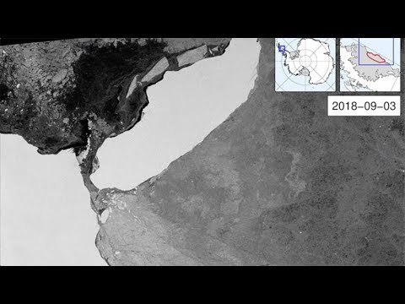
A massive Antarctic iceberg the size of a small country is heading for the island of South Georgia with concerns it could disrupt the British territory’s economy and its wildlife. The giant floating ice island (A-68A) is now about 500km away from the South Georgia in Antarctica.
A68a - which has the look of a hand with a pointing finger - has been riding this "iceberg alley" since breaking free from Antarctica in mid-2017. It's now just a few hundred km to the southwest of South Georgia.

Slide 8
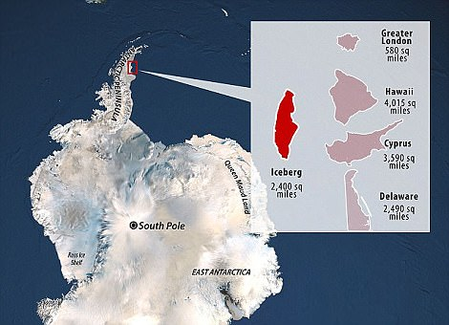
The Antarctic ice giant A68a is a similar size to the South Atlantic island of South Georgia, and there's a strong possibility the berg could now ground and anchor itself offshore of the wildlife haven.
If that happens, it poses a grave threat to local penguins and seals.
The animals' normal foraging routes could be blocked, preventing them from feeding their young properly.
And it goes without saying that all creatures living on the seafloor would be crushed where A68a touched down - a disturbance that would take a very long time to reverse.
"Ecosystems can and will bounce back of course, but there's a danger here that if this iceberg gets stuck, it could be there for 10 years," said Prof Geraint Tarling from the British Antarctic Survey (BAS).
"And that would make a very big difference, not just to the ecosystem of South Georgia but its economy as well," he told BBC news.

Slide 9
What is happening here? (slides 7 & 8)
Possible enquiry questions
Points to note: Gg aspects/dimensions, locations, concepts & potential Gg vocab etc.
Where is this happening? (Where is South Georgia etc?)
What can we see in the photograph?
What name (number) has it been given?
What do we know?
What is the weather like?
What is at risk in this area of the world?
What is happening in the South Atlantic ocean/southern hemisphere?
In the news last week: Hurricane Zeta; Storm Aiden; giant iceberg in the South Atlantic; UK floods – each would allow ways in to issues of climate change
Observational skills; map/atlas skills
Contextual world & locational knowledge
Antarctica, South Georgia, Atlantic Ocean
Ocean, ice, hemisphere, south, iceberg, island, ecosystem,

Slide 10
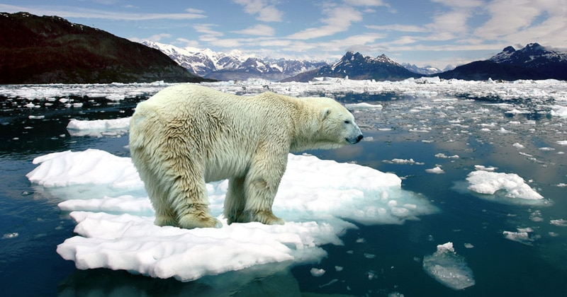
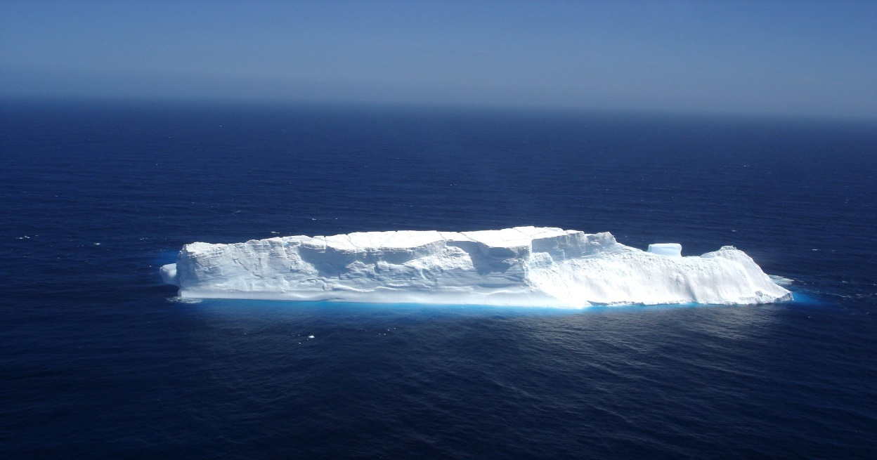
& what can you see here?

Slide 11
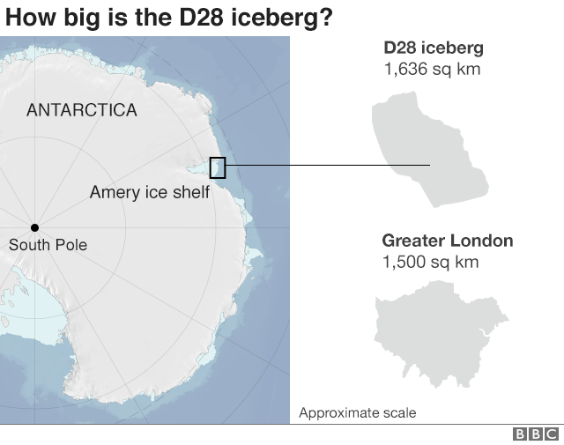
How big is the D28 iceberg? How does it compare with A68?
Two very big icebergs are currently afloat in the South Atlantic (along with other smaller ones)
D28 is dwarfed by the mighty A68 berg (slide 7), which broke away from the Larsen C Ice Shelf in 2017.
It currently covers an area more than three times as big.

Slide 12
The Amery Ice Shelf in Antarctica has also produced its biggest iceberg (D28) in more than 50 years.
Almost a quarter of the West Antarctic Ice Sheet can now be considered unstable, according to a new assessment of 25 years of satellite data.
By unstable, scientists mean more ice is being lost from the region than is being replenished through snowfall.
Some of the biggest glaciers have thinned by over 120m in places.
Losses from the two largest ice streams - Pine Island and Thwaites - have risen fivefold over the period of the spacecraft observations.
And the changes have seen a marked acceleration in just the past decade.
The driver is thought to be warm ocean water which is attacking the edges of the continent where its drainage glaciers enter the sea.
The calved block covers 1,636 sq km in area - a little smaller than Scotland's Isle of Skye - and is called D28.
The scale of the berg means it will have to be monitored and tracked because it could in future pose a hazard to shipping.
Not since the early 1960s has Amery calved a bigger iceberg. That was a whopping 9,000 sq km in area.
Amery is the third largest ice shelf in Antarctica, and is a key drainage channel for the east of the continent.

Slide 13
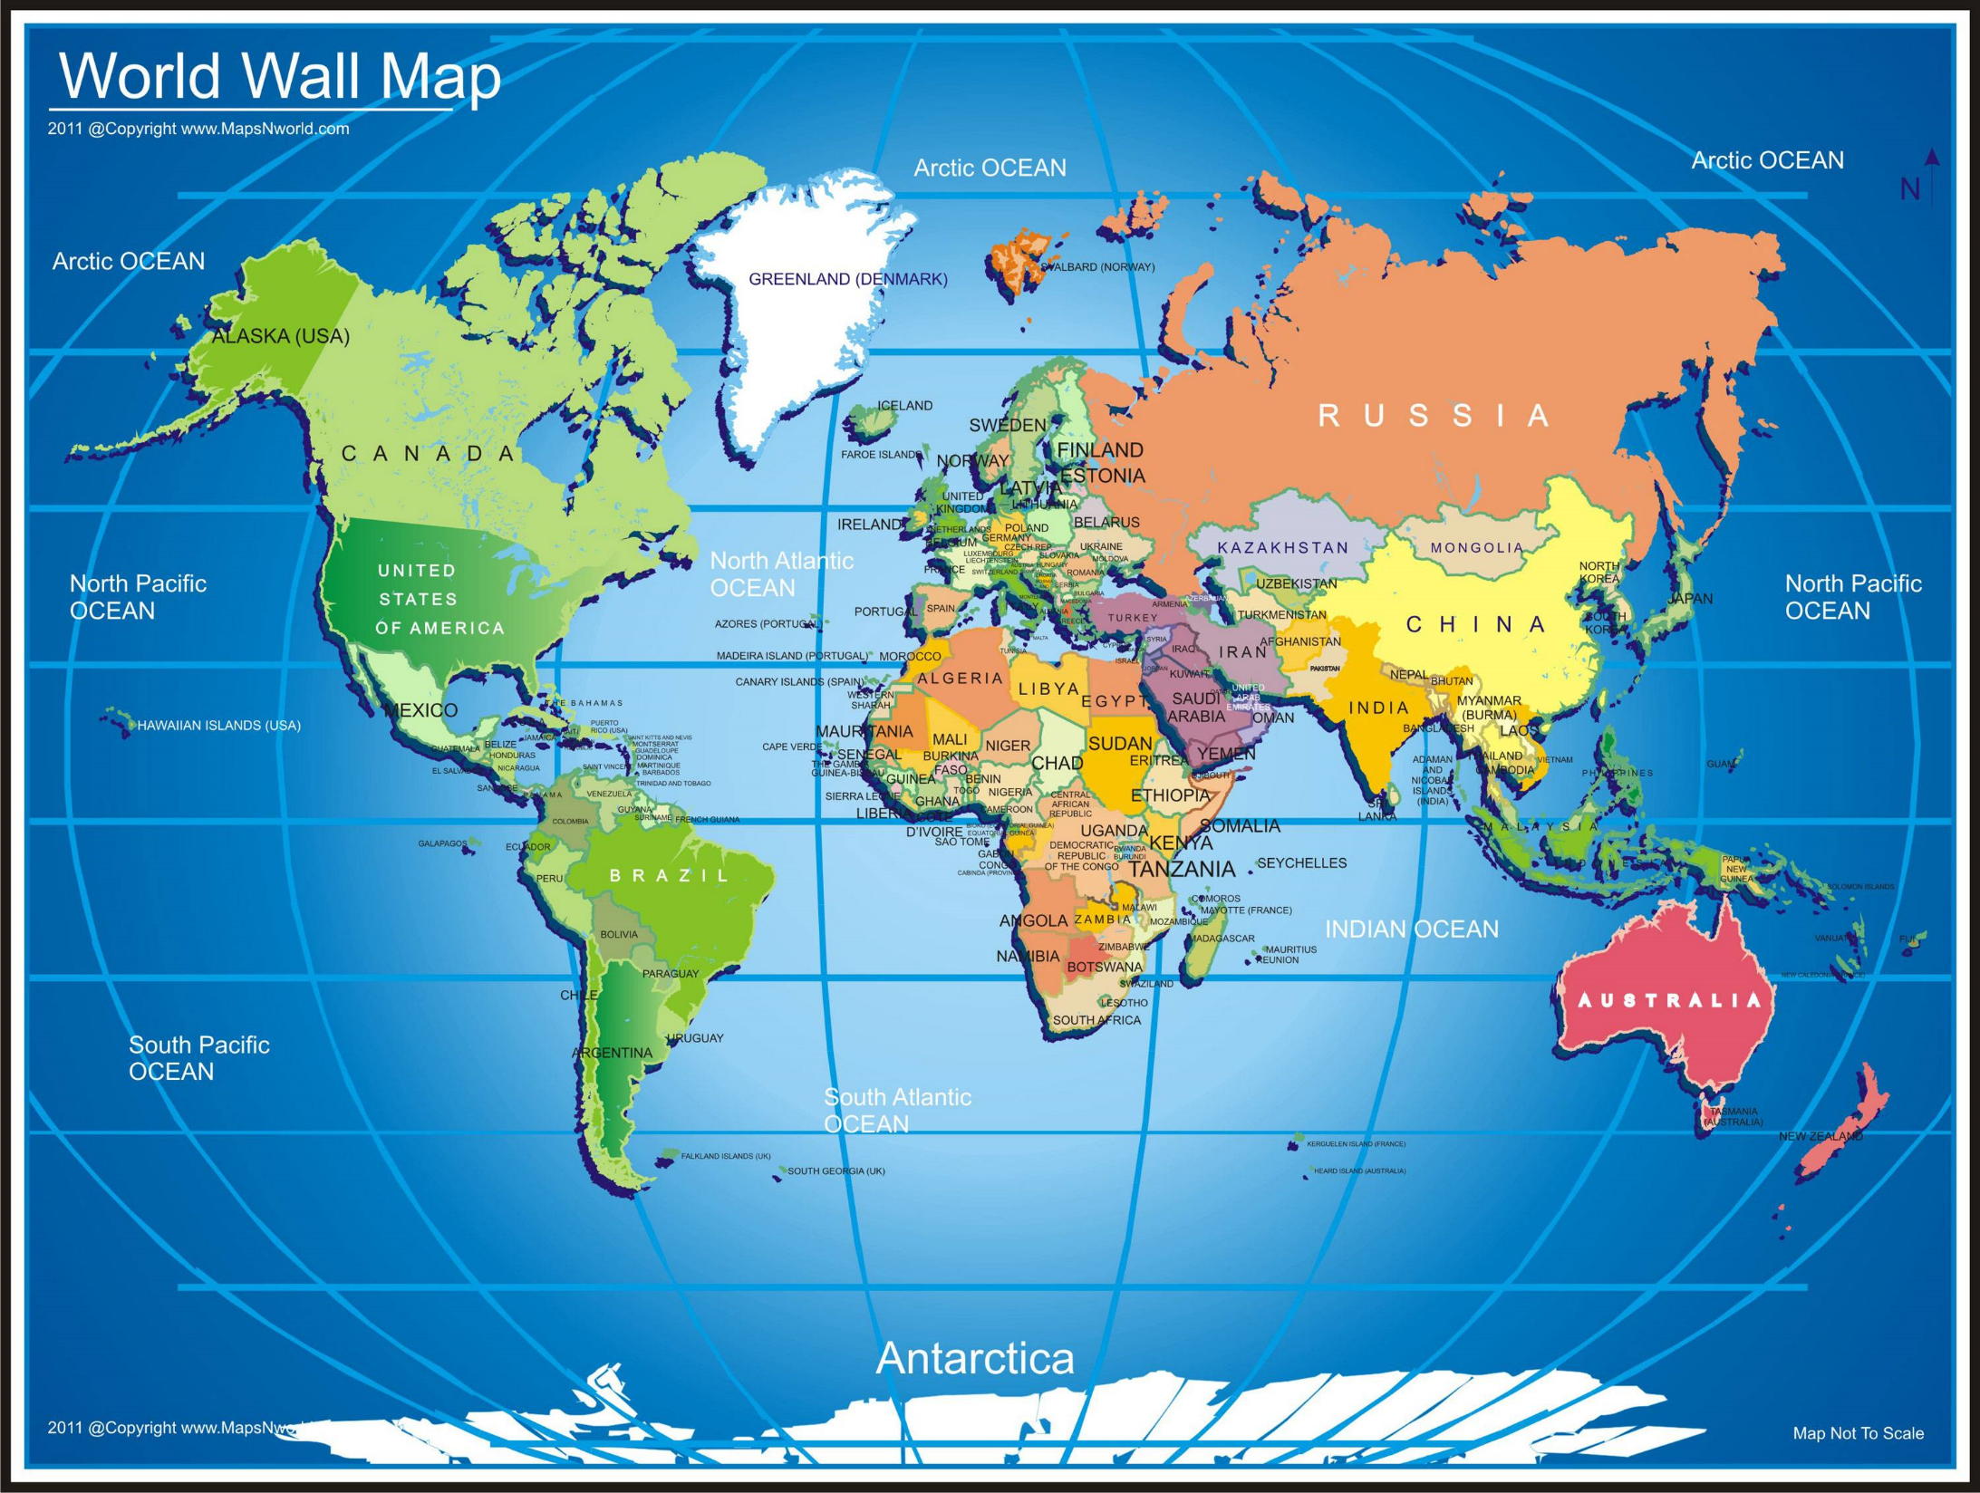

Slide 14
So - what is happening in the South Atlantic? (slide 10)
Possible enquiry questions
Points to note: Gg aspects/dimensions, locations, concepts & vocab etc.
What is this second iceberg called?
Where is the South Atlantic?
Where is Antarctica? What does it often get called?
What is the climate like here?
What is happening to the ice at the South Pole and why?
What is meant by climate change? >>>>
Rising sea temperatures; fracturing sea ice; effects on wildlife; risks to human settlements
Contextual world & locational knowledge
Understanding
Enquiry - observational skills; mapskills
Antarctica, South Pole, South Georgia, Atlantic Ocean
Ocean, hemisphere, south, ice shelf, ice sheet, iceberg, glacier, island, ecosystem
Fracture, ‘calve’ an iceberg; hazard, global warming, climate change

Slide 15
What is climate change?
Possible enquiry questions
Points to note: Gg aspects/dimensions, locations, concepts & vocab etc.
What are the factors that affect the climate? Why is it in the news so much?
How much agreement is there?
Why do some people disagree?
What is the difference between climate and weather?
Contextual knowledge;
Factors: Latitude; ocean currents; wind, elevation, relief; nearness to water
Climate, weather,
Cause& effect
Debate; consent, dissent; comparisons;

Slide 16
Why is climate change happening?
Possible enquiry questions
Points to note: Gg aspects/dimensions, locations, concepts & vocab etc.
What are the causes – natural and human?
What are the effects?
How does carbon (and other pollutants) get into the atmosphere?
Why now?
Contextual knowledge:
Physical (natural) geographical processes
Changing weather patterns; rising temperatures; changes in the sun’s energy; planetary movements; release of carbon from melting permafrost.
Human agency:
Industrial development; fossil fuels; increase in greenhouse gases; animal husbandry, deforestation; Population pressures & pollution
Impact on wildlife & ecosystems; food production and supply; danger to supply of safe, drinking water; damage to
Cause & effect; impact
Vocab. Carbon, atmosphere, pollution

Slide 17
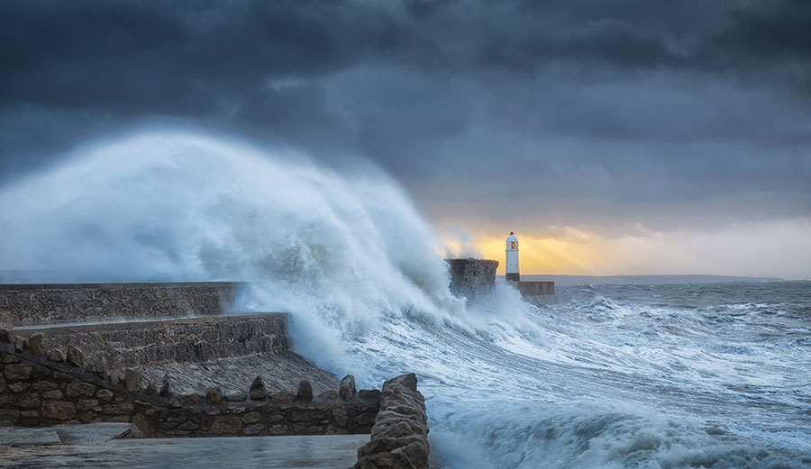
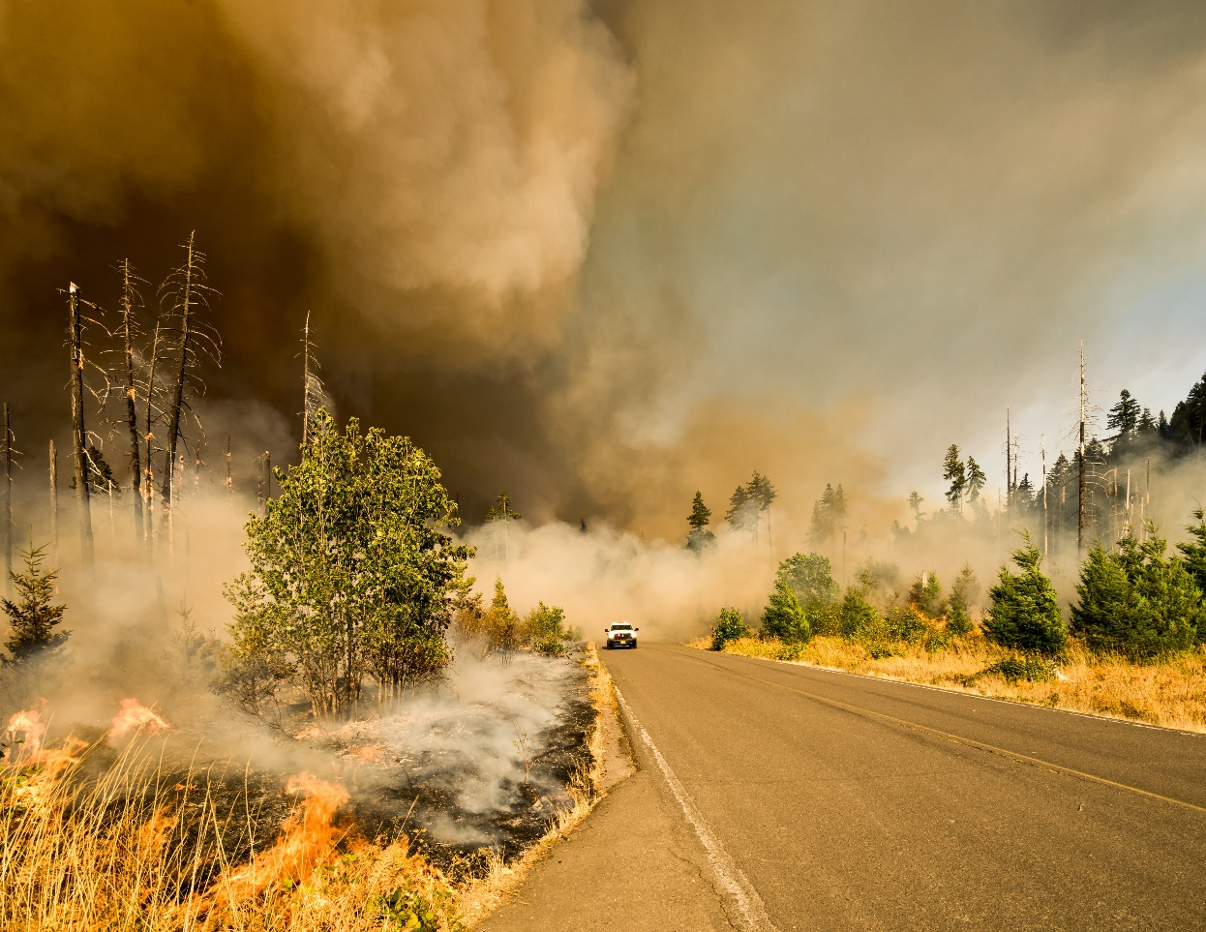
Examples of extreme weather events

Slide 18
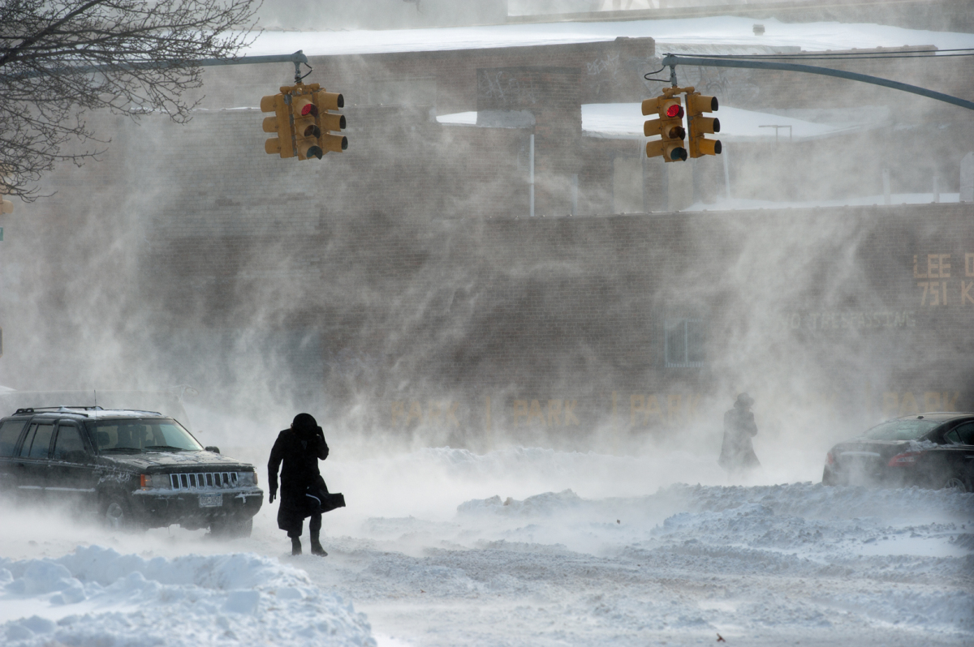
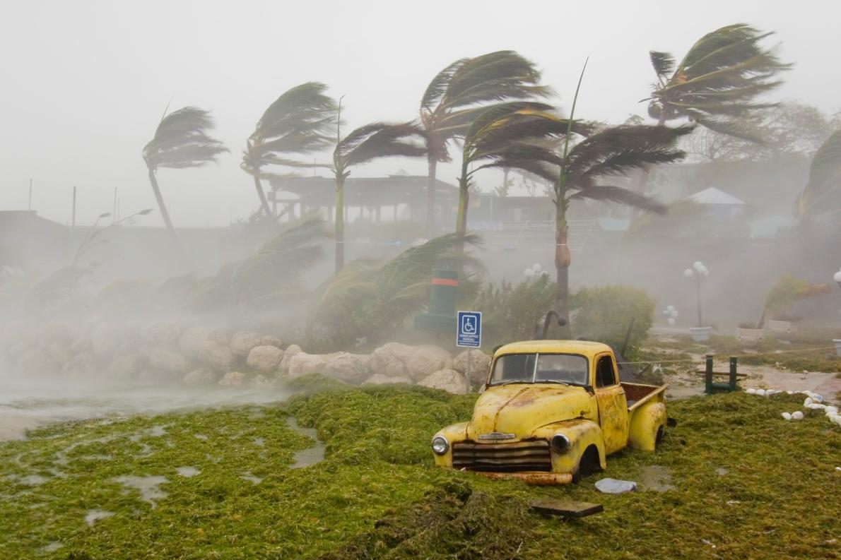

Slide 19
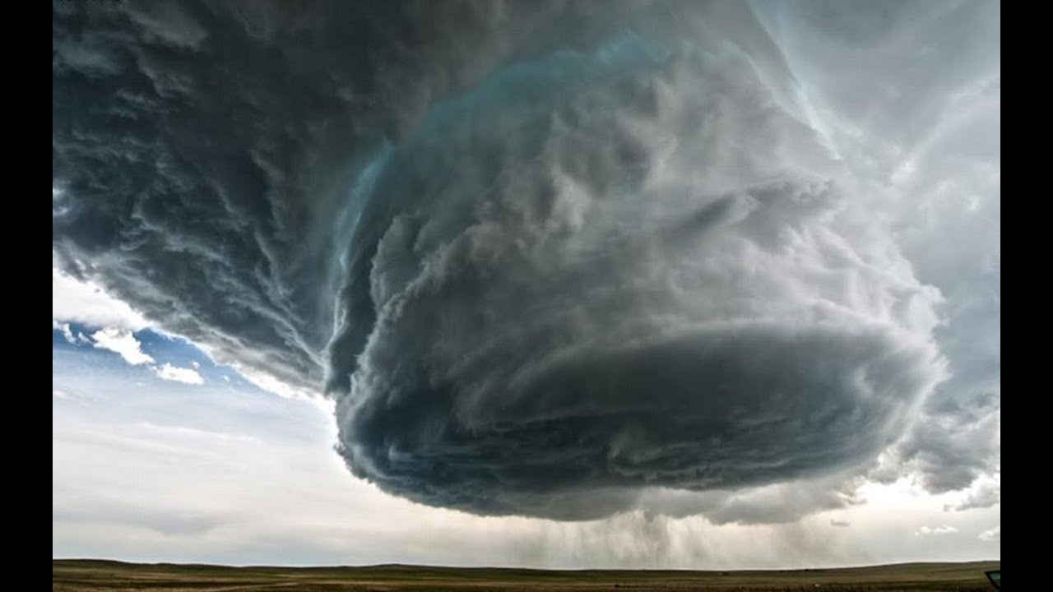
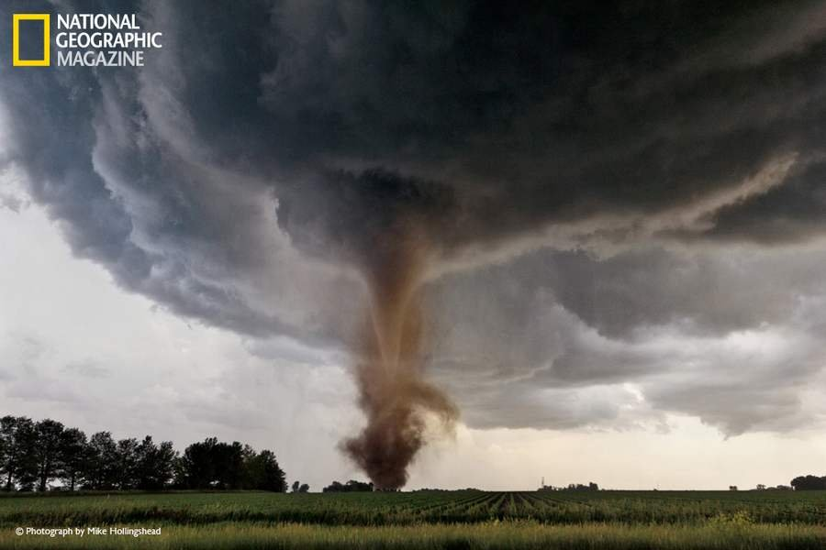

Slide 20
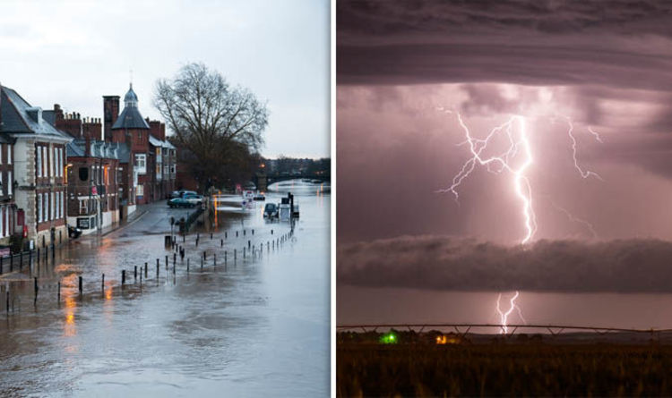

Slide 21
What do we mean by ‘extreme weather’?
Possible enquiry questions
Points to note: Gg aspects/dimensions, locations, concepts & vocab etc.
Where and how often do extreme weather events occur?
How does it link to the climate? What is the difference between the two?
What factors affect the climate?
Opportunity to explore concept of climate ‘change’
NB CL activities e.g Hurricane Irma; Extreme weather; Rain forest et al)
http://www.collaborativelearning.org
Choice of global and locational contexts
Extreme weather
Storms, hurricanes, cyclones, high temperatures, drought, heavy rains, floods, extremes of heat and cold,
Climate vs weather – long and short term
Cause & effect
6 factors: latitude, ocean currents & varying temperatures,wind, elevation, relief, proximity to water)

Slide 22
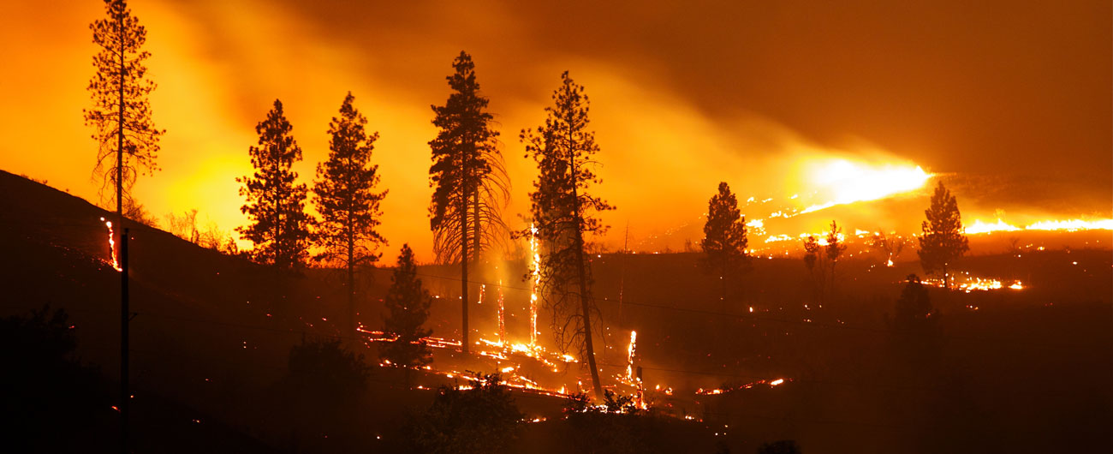
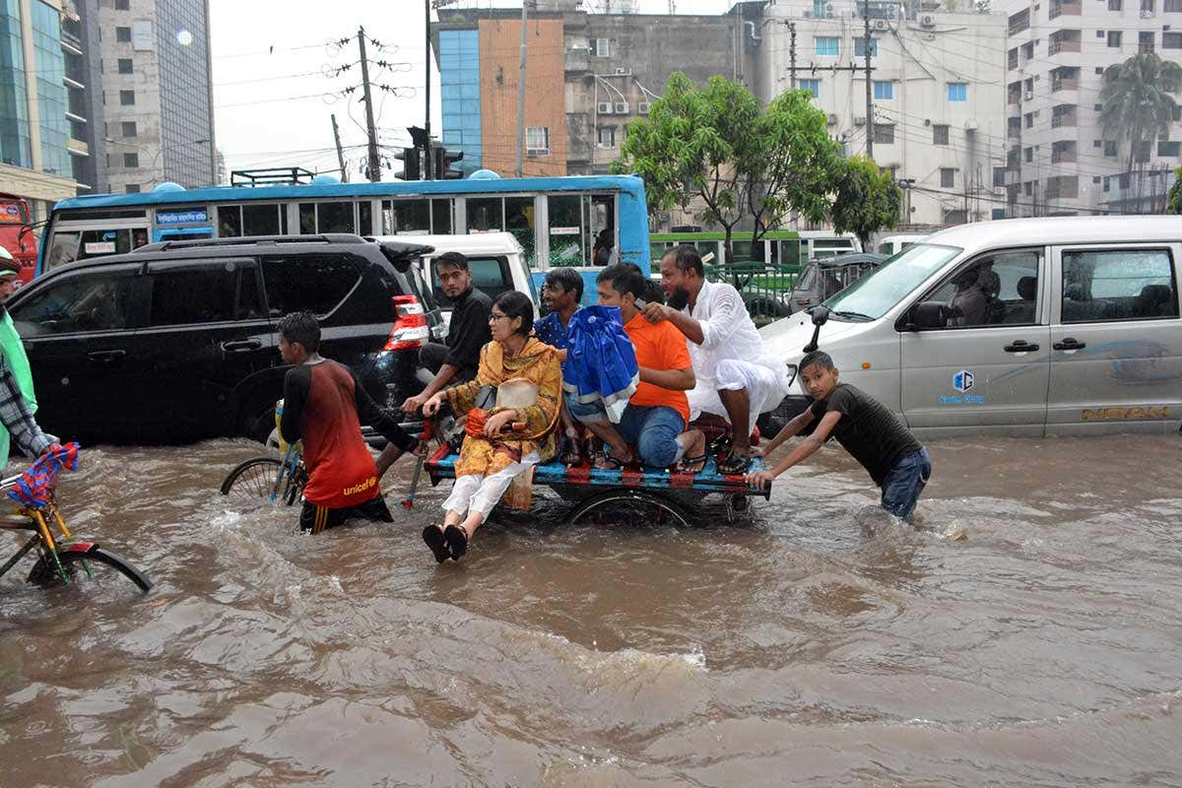
Some effects of extreme weather

Slide 23
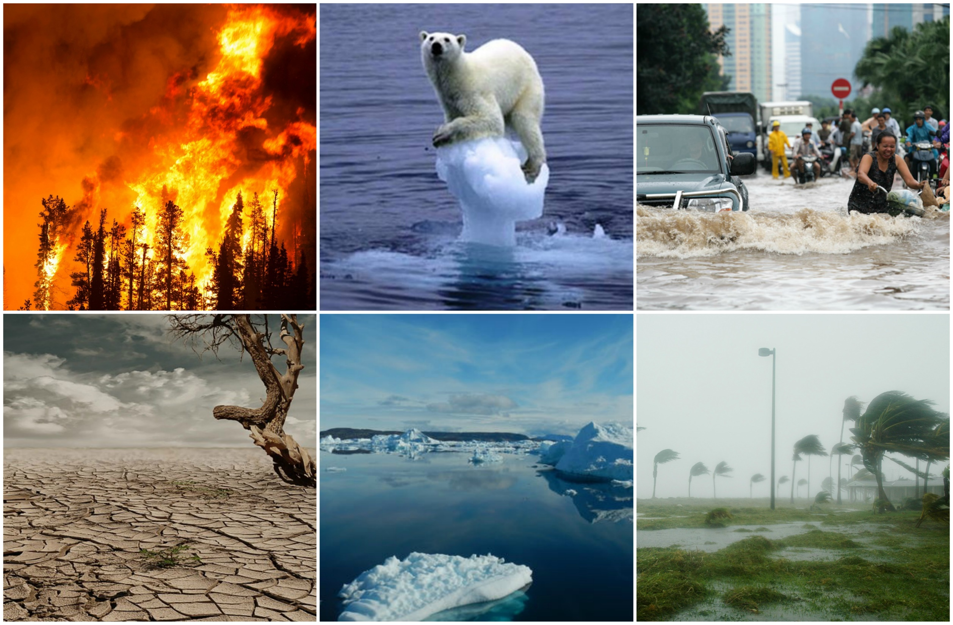

Slide 24
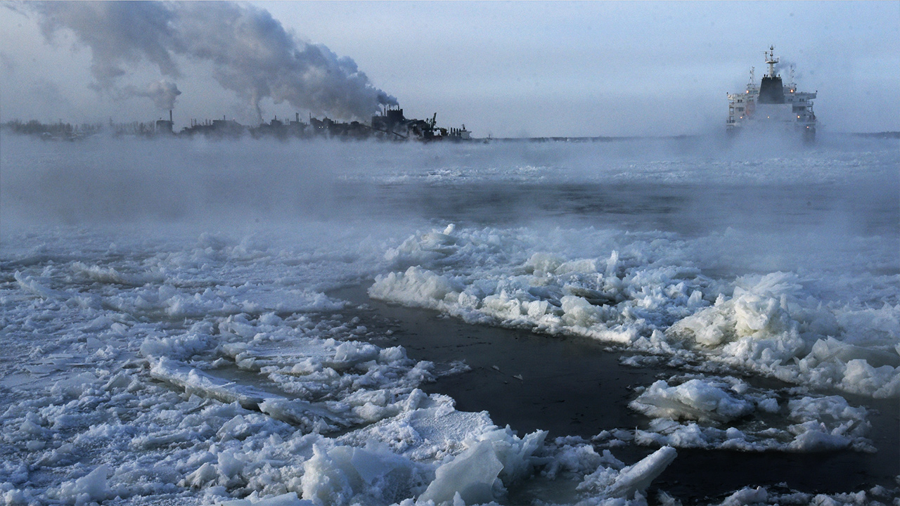
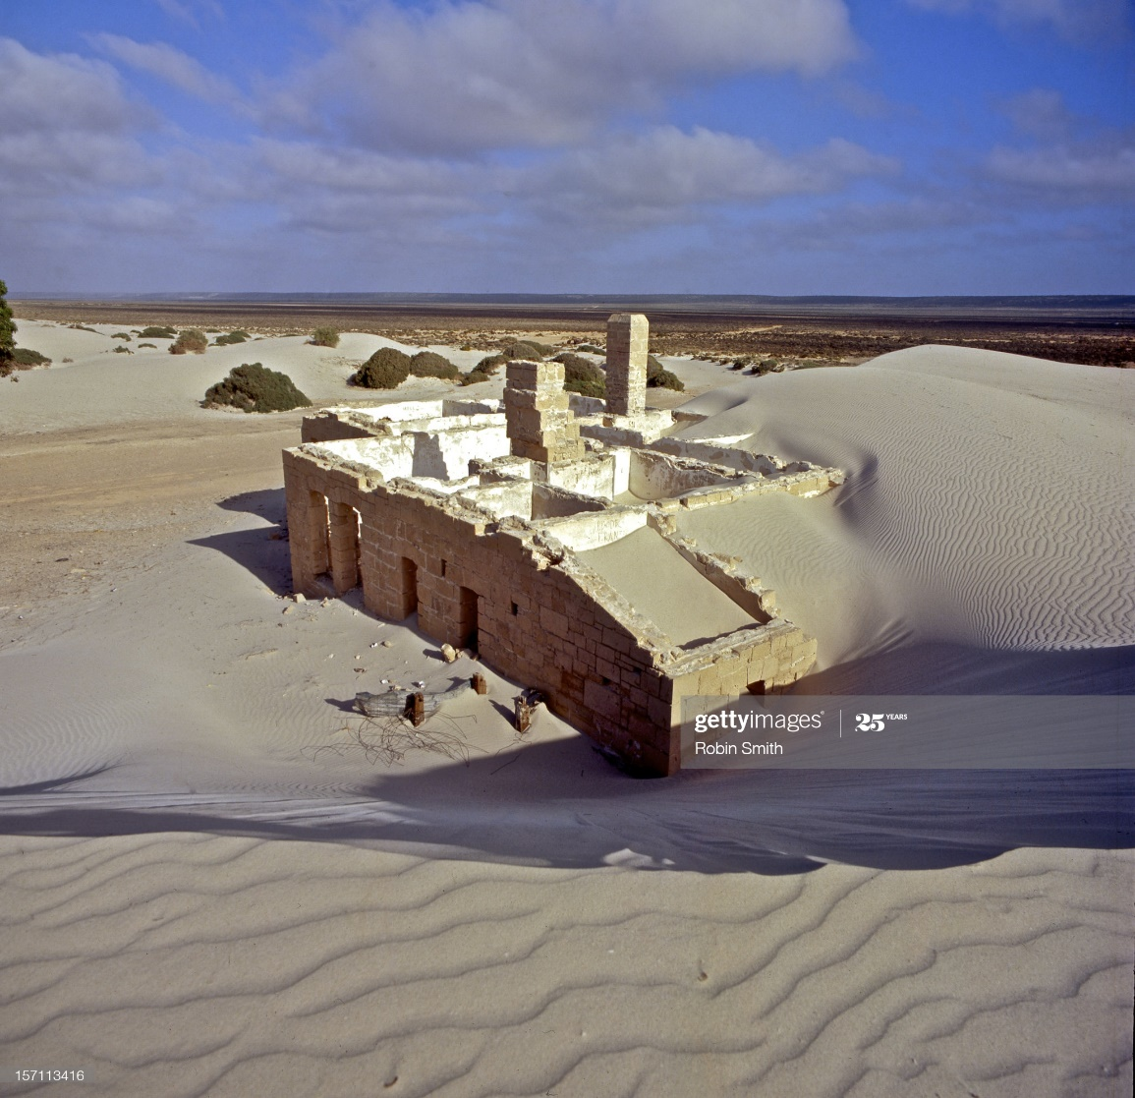

Slide 25
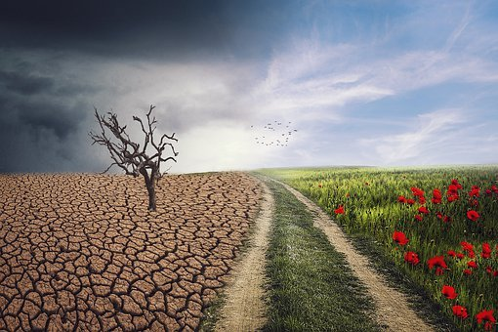
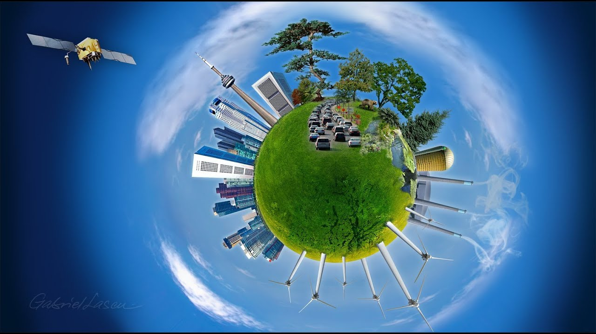

Slide 26
How is climate change related to natural disasters?
Possible enquiry questions
Points to note: Gg aspects/dimensions, locations, concepts & vocab etc.
What is the evidence for climate change and natural disasters to share common features or be linked?
How do scientists interpret what is happening?
Greater frequency of serious environmental problems
e.g. pandemics and infectious diseases; fires; land (and river) management and floods; agricultural practices; volcanic and tectonic activity; acidification of the sea e.g bleached coral reefs, coastal erosion
NB hottest and wettest years in the UK have been in the very recent past

Slide 27
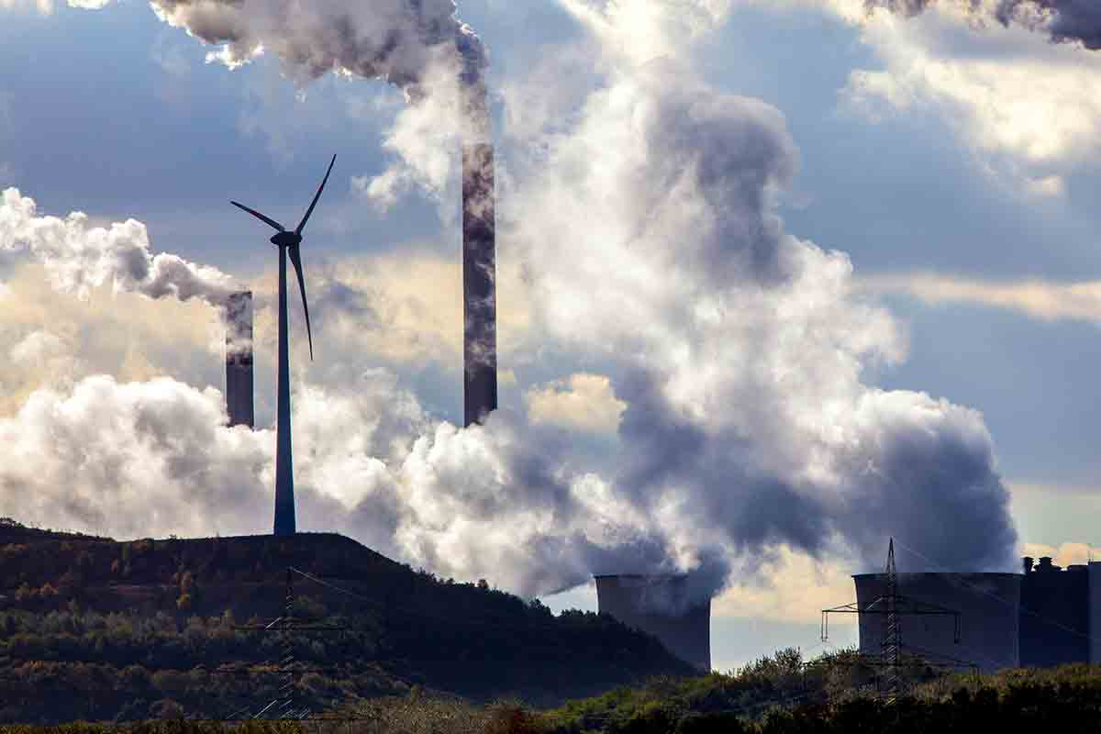
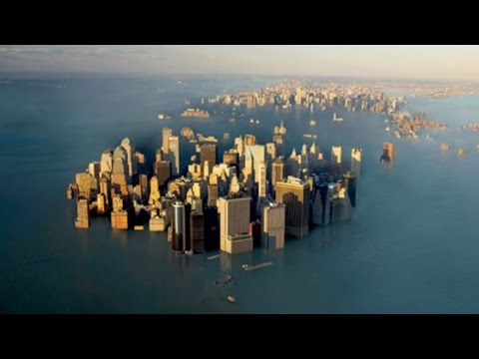
What’s to do?

Slide 28
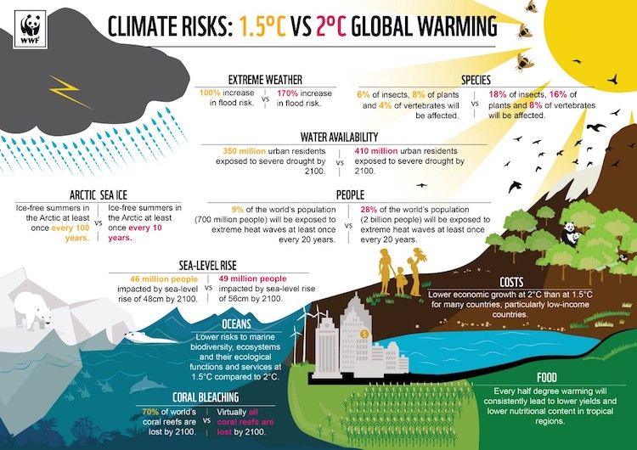

Slide 29
What is needed?
Possible enquiry questions
Points to note: Gg aspects/dimensions, locations, concepts & vocab etc.
What solutions do scientists and others suggest?
How urgent is the crisis?
How do governments need to work?
How should businesses, farmers and others behave?
Biodiversity damage in UK amongst the worst in developed world
Exacerbating pollution
Changes to energy, lower emissions; supply chains, agriculture & food supplies;
Tree planting; renewable energy; biofuel crops; green transport; clean air zones
NB Bug burgers Primary geography (GA) article

Slide 30
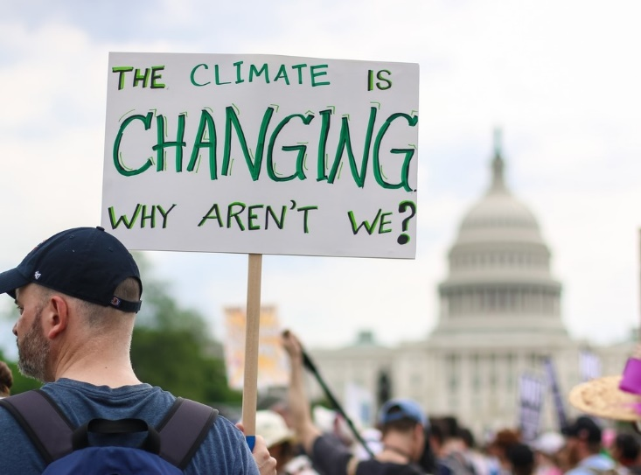
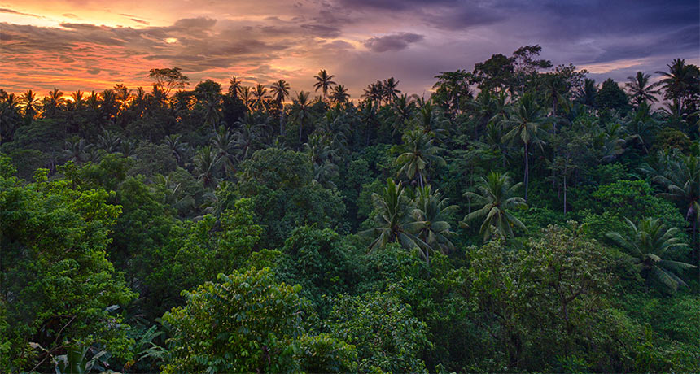
Who’s doing what?

Slide 31
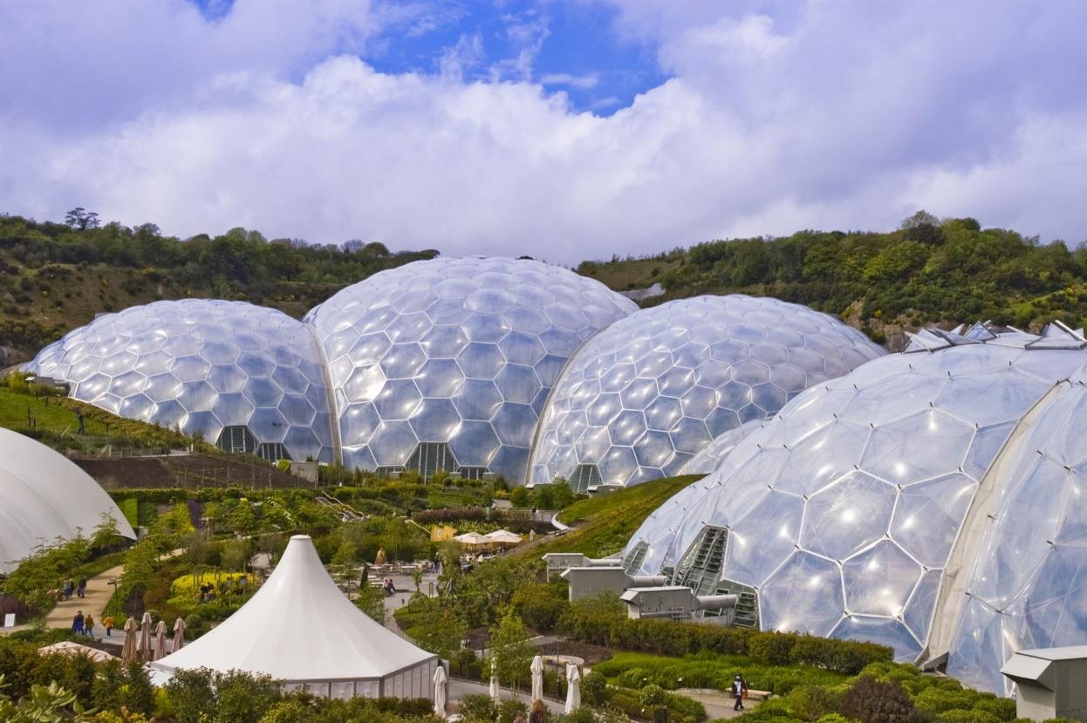
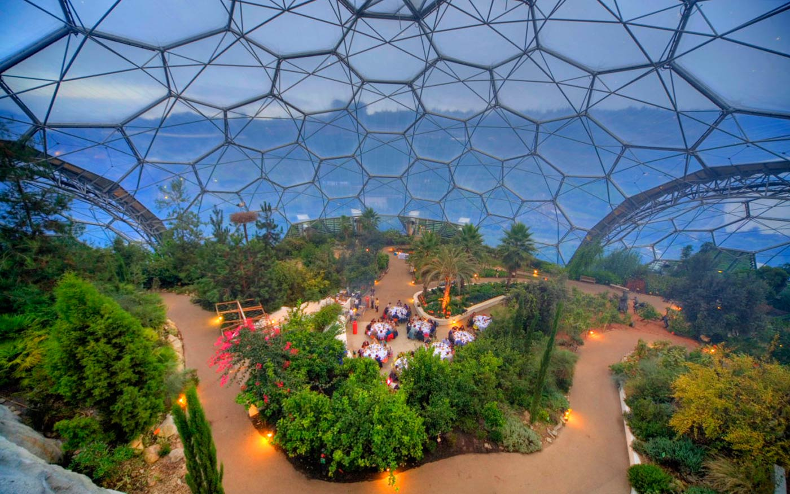
The Eden Project in Cornwall

Slide 32
Who is taking action?
Possible enquiry questions
Points to note: Gg aspects/dimensions, locations, concepts & vocab etc.
Governments, politicians & political parties; activists (Greta Thurnberg, Caroline Lucas & Green Party); Pressure groups; NGOs; (some) manufacturers, industries and businesses; private individuals;
Initiatives – e.g. Eden Project
Forest schools (UK)
IPCC

Slide 33
What can I/we do?
Possible enquiry questions
Points to note: Gg aspects/dimensions, locations, concepts & vocab etc.
Opportunity for active citizenship activities in and/or across the school e.g ……..

