Slide 1
Humanities SL INSET
History
November 2020
Kate Moorse

Slide 2
Introductions, plan for the morning
Welcome & introductions
How this session is going to work (hopefully!)
Main foci
Co-ordinator role & curriculum audit
‘Mastery’ in history
Enquiry
Diversity & the curriculum (BLM/Black history and other opportunities)
(using polls, break out group discussions & 2 tasks)

Slide 3
POLLS - Who’s here today? - 1
How long have you been subject leader for history?
5 yrs +
1-5yrs
Less than one year
Just this term

Slide 4
POLLS - Who’s here today? - 2
Which key stages do you have responsibility for?
EYFS + KS1
KS1 only
KS2 only
KS 1 & 2
All key stages

Slide 5
POLLS - Who’s here today? - 3
When did your own history education stop?
At 14
At 16 (GCSE)
At 18 (A’ level)
With a history degree?

Slide 6
POLLS - Who’s here today? - 4
Do you have responsibility for geography too?
Yes/no

Slide 7
Bearing in mind the role of the subject leader in auditing provision….
Re-visiting planning and preparation with progression in mind KS1>2
Building on pupils’ existing knowledge and anticipating future learning
Implications for teachers’ subject knowledge.
Notes:
http://www.collaborativelearning.org/05assessment.pdf
HA – Jamie Byrom
http://www.collaborativelearning.org/04coordinator.pdf
Curriculum indicators (co-ordination)

Slide 8
… and given that ….
Ofsted is alive and well – and has survived the pandemic!! – so the emphasis is (happily) still on delivering the whole curriculum.
The lockdown will have meant that individual children and groups of children have had very variable access to the humanities.
What challenges face you in your role…. See slide 9

Slide 9
Group discussion – the last 6 months and the curriculum
What have been any developments and issues for history (especially those arising since March)?
What strategies have schools used to support learning since Covid struck?
What are the implications for teaching and learning in the light of current constraints? What provisions are in place in the case of disruption?
What resources (on-line & other) have you seen/found that have been useful – & that you’d like to share with colleagues?

Slide 10
Break out rooms for discussion (1)
See next slide (11)

Slide 11
1. Links Re: mastery & enquiry
(for chat section)
http://www.collaborativelearning.org/05assessment.pdf
http://www.collaborativelearning.org/05enquiry.pdf
http://www.collaborativelearning.org/04coordinator.pdf
http://www.collaborativelearning.org/activities.html

Slide 12
Mastery in history
What is meant by ‘mastery’ in history? What do we want it to mean?
“the level of achievement of a particular standard or how well a student needs to know something in order to apply that skill,”
expert skill or knowledge
What does this look like?
Notes:
Chronological understanding (or memory) often taken to be the mark of success (or popular benchmark) in history but we must set that alongside a number of other considerations …. http://www.collaborativelearning.org/05assessment.pdf

Slide 13
Mastery Model of Learning
History and Geography
1. Procedural knowledge – particular, discrete and often
decontextualised ‘knowing’;
2. Concept building – formulating general and often
abstract ‘big ideas’ from the particular and discrete
information which learners ‘know’;
3. Procedural fluency – applying concepts in new and
unfamiliar contexts – connected, joined and linked
‘thinking as a historian or geographer’.
Notes:
Notes on Mastery:
The word mastery appears in assessment systems and in discussions about assessment. Unfortunately, it is used in a number of ways and there is a risk of confusion if it is not clear which meaning is intended.
Many schools seem to have adopted the word ‘mastery’ to denote a high level of performance against curriculum expectations.
Mastery has also been associated with particular teaching approaches; for example with the recent promotion of mathematics Mastery. Here, ‘mastery’ denotes a focus on achieving a deeper understanding of fewer topics, through problem-solving, questioning and encouraging deep mathematical thinking.
Also sometimes associated with this ‘mastery’ approach is a belief that all children can achieve a high standard.
‘Mastery Learning’ is a specific approach originally developed by Bloom in the 1960s. In Bloom’s version, learning is broken down into discrete units and presented in logical order. Students are required to demonstrate mastery of the learning from each unit before being allowed to move on to the next, with the assumption that all students will achieve this level of mastery if they are appropriately supported; some may take longer and need more help, but all will get there in the end.
Assessment [formative] is built into this process…[the teacher] identifies specific ‘corrective’ activities to help them do this.
The current national curriculum is premised on this kind of understanding of mastery, as something which every child can aspire to and every teacher should promote.
Levels were considered not consistent with this approach as they encouraged progression onto more difficult work while pupils still had gaps in their knowledge or understanding.

Slide 14
Caveats
Theory generated from experience in maths and speaks to linear subjects (and certain aspects of subjects) more easily than to the humanities
Humanities – and especially history is far too ‘messy’
Need therefore – to define what it should mean in our subjects.
Notes:
Likely to span a wider range of time and processes in the humanities (in maths it seems to focus on mastering the aims, objectives & content of a lesson or particular transaction before moving on to the next topic, process or stage) i.e. an incremental or linear model.
In the humanities, progress will be relative to context and involve a number of strands developed over a longer period. It is incremental but far more difficult to assess piecemeal.
The research proffered cites frequent testing (and repetition) as a reliable mechanism for setting to memory and consolidating learning. If we are to adopt these practices, we must be clear about what it is useful to test, when and how frequently and balance this against the amount of curriculum time available and range of desirable learning experiences we want to provide.
Must not risk ‘reductionism’ to a narrow focus of fact checking to the exclusion of more holistic web of substantive subject knowledge, conceptual development and enquiry methodology.

Slide 15
…more caveats re: the humanities
Likely to span a wide range of time and processes (in maths it seems to focus on mastering the aims, objectives & content of a lesson or particular transaction before moving on to the next topic, process or stage) i.e. an incremental or linear model.
In the humanities, progress will be relative to context and involve a number of strands developed over a longer period. It is incremental but far more difficult to assess piecemeal.
The research cites frequent testing (and repetition) as a reliable mechanism for setting to memory and consolidating learning. If we are to adopt these practices, we must be clear about what it is useful to test, when and how frequently and balance this against the amount of curriculum time available and range of desirable learning experiences we want to provide.
Must not risk ‘reductionism’ to a narrow focus of fact checking to the exclusion of a more ‘holistic’ web of substantive subject knowledge, conceptual development and enquiry methodology.

Slide 16
History - lesson & curriculum ingredients
Methods of enquiry
Disciplinary knowledge
Substantive knowledge

Slide 17
Substantive knowledge
This is factual content about people and events. You cannot teach history without historical facts. However, a fact in isolation means very little unless it is put in context. Thus, substantive knowledge is also about how facts are framed chronologically and how facts are linked together and connections made across and within time periods. Substantive knowledge is also about exploring key concepts such as power, empire, democracy and trade. Children will need to understand these concepts if they are to make sense of what they are learning.

Slide 18
Disciplinary knowledge
This is sometimes known as second-order concepts or procedural knowledge. This is how historians debate history. It is therefore a question of considering why something happens (causation) why it might be important (significance) and how it can be viewed in different ways (interpretation). It is also about understanding continuity and change and giving children a sense of period so that they can have some understanding of what life was like at a different period of time.

Slide 19
Methods of enquiry
The third circle is about how children will investigate history and communicate it. A good history lesson should be framed around a key question for the children to investigate and they should have opportunities to ask questions about sources that they use and draw conclusions from the evidence. They should be able to use a variety of ways of communicating their responses.

Slide 20
The curriculum as the model for progression
If the schemes of work are planned well under the umbrella of an overarching enquiry question and each lesson supports and extends the next then children will be able to make progress in their understanding of history. The curriculum itself is therefore the model for progression.
pupils should come away from their history lesson curious, motivated and keen to know more.

Slide 21
Why is Historical Enquiry so important?
Anyone ‘doing’ history, from pupils in primary school to those doing research and writing books, is undertaking enquiries, i.e. aiming to answer questions and deepen their knowledge and understanding. Enquiry is one of the cornerstones of the discipline of History, providing a common thread as children progress and mature from primary to secondary school.

Slide 22
Historical Enquiry’s place in mastery
It’s important that the enquiry process is made explicit so that pupils can use it with increasing independence as they mature. It’s equally important that children appreciate that enquiry is a common thread in their study of history. One reason children can find history difficult is because they constantly feel they’re starting again. They think each new topic is completely different because it features new names, dates, places etc. This new detail acts as camouflage, preventing pupils realising that they can use what they’ve learned before to help them with a new topic. In contrast the enquiry process is the same each time, regardless of the historical topic or period, and children gain confidence because they know the steps to take in exploring a new topic.

Slide 23
So what is the process of Enquiry?
A pragmatic approach or definition:
look at a source or two
ask questions about this material
suggest a hypothesis (a possible answer) to your question/s
investigate some more source material
use this new material to test and build your hypothesis until you reach an answer you are happy with.

Slide 24
http://www.thinkinghistory.co.uk/ActivityBase/EnquiryImportance.html
Enquiries’ are sometimes seen as one-off ‘mystery’ items but this is a complete misconception.
An Enquiry can last half a term, a term or even longer.
They may begin by focussing on a single discovery or excavation (as at Sutton Hoo for example) but such a mystery enquiry is best seen as a ‘mystery starter’, an intriguing doorway into a much more substantial enquiry.

Slide 25

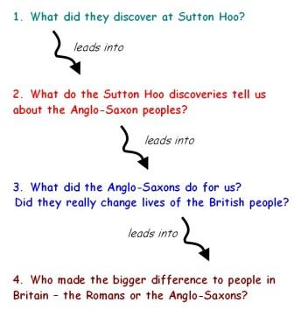
Using the Sutton Hoo excavation as an example - think of it as the smallest of a series of Russian dolls building a scheme of work

Slide 26
and another thing ….
We can never know, study or learn everything there is that falls under the definition of ‘history’, topic or period – we therefore need to find ways of selecting and rationalising to make studies manageable …
Enquiry provides both a rationale and a route through a wealth of content by giving focus and providing possible learning pathways.

Slide 27
BUT…
We have to anticipate in our planning what knowledge will be required to make the most of what an enquiry has to offer. ….
And then – contrive that learners are able to encounter or acquire this at appropriate points on the way through.
We also need to have thought about how one topic or period relates to and builds on those that have gone before – and find ways of making that explicit to learners – essential for ‘chronological understanding’.
SO – what are the implications for teachers’ subject knowledge?
Notes:
One of the criticisms of the curriculum as currently constructed has been that it tends to lead to episodic and disjointed learning that gets in the way of understanding the ‘bigger picture’. This has always been the case – even when it has been a trot through time in the home country (i.e. this island’s story). There will always be gaps. Both teacher and learner must be aware of that. Building a repertoire of enquiry questions and attempting to answer them in a variety of contexts will quickly make this apparent

Slide 28
AND ……
Having a scheme of work full of enthusing enquiry questions is not enough to develop pupil’s understanding of ENQUIRY if all the posing of questions and structuring of enquiry is done by the teacher. An effective scheme must help pupils build the ability to ask their own questions and plan their own way through enquiries, simultaneously using and developing their understanding of historical enquiry.
Notes:
http://www.collaborativelearning.org/05assessment.pdf
HA – Jamie Byrom
http://www.collaborativelearning.org/04coordinator.pdf
Curriculum indicators (co-ordination)

Slide 29
Links re: task 1 – Sutton Hoo
http://www.collaborativelearning.org/05assessment.pdf
http://www.collaborativelearning.org/05enquiry.pdf
http://www.thinkinghistory.co.uk/ActivityBase/SuttonHooBurial.html
http://www.thinkinghistory.co.uk/ActivityBase/SuttonHooBackground.html
http://www.thinkinghistory.co.uk/ActivityBase/SuttonHooEnquiry.html

Slide 30
Task 1 – Sutton Hoo case study
Review the Sutton Hoo enquiry as a scheme of work/sequence of learning http://www.collaborativelearning.org/05enquiry.pdf
Refer to HA Progression in History document http://www.collaborativelearning.org/05assessment.pdf
In your groups – select a segment & think through responses to the set of ‘deep dive’ questions on the next slide.
You will be feeding back on those aspects in bold so spend more time on them…

Slide 31
Possible Key stage 1 task re: Sutton Hoo
Without worrying about the wider Anglo-Saxon context – you might focus on a single aspect that could be customised for an enquiry e.g.
An archaeological dig and physical evidence – perhaps a sand tray with buried objects/artefacts
Or
A single or group of objects …..
The helmet is one of the British Museum’s Teaching History with 100 objects
http://www.teachinghistory100.org/
http://www.teachinghistory100.org/objects/sutton_hoo_helmet
https://www.britishmuseum.org/learn/schools/ages-7-11/ancient-britain/classroom-resource-sutton-hoo-introduction

Slide 32
Deep Dive type questions…(viz.Ofsted)
How well is a series of lessons sequenced within the intended curriculum and how well do they provide purposeful opportunities for pupils’ progression through it?
What is the purpose of a lesson or task, how does it fit into a sequence of lessons over time, and what do pupils already know and understand.
How are teachers supported to both develop their subject knowledge alongside pedagogical knowledge and to teach the component knowledge leading to NC outcomes?
How are teachers supported to ask specific questions related to the school curriculum content? … e.g. ‘give me an example of something that is a taught in Y2 that is built on in Y4 and Y6’
How have you built on learning in Y3? … in Y5?
Notes:
Ofsted’s notes to inspectors on Deep Dives
‘It’s not about making judgements, it’s about asking questions’
Focus on intent choice & sequencing, focus on appropriate pedagogy not general pedagogy
Focus on - do pupils know more and remember more rather than the old concept of progress?
Work scrutiny is not about judging progress but is about seeing what the planned curriculum looks like in practice or how successfully the curriculum has been enacted.
Is the stated curriculum evident in books? Are pupils drawing on a wide range of prior knowledge? A unit of learning is a sequence of lessons not an individual lesson.
for chart on curriculum indicators http://www.collaborativelearning.org/04coordinator.pdf

Slide 33
Task resources
Resources
Likely focused ‘deep dive’ questions posed by inspectors (previous slide no 37)
Progression in History document http://www.collaborativelearning.org/05assessment.pdf
Sutton Hoo enquiry/sequence of work http://www.collaborativelearning.org/05enquiry.pdf
Notes:
For related resources on Sutton Hoo
http://www.thinkinghistory.co.uk/ActivityBase/SuttonHooBurial.html
http://www.thinkinghistory.co.uk/ActivityBase/SuttonHooBackground.html
http://www.thinkinghistory.co.uk/ActivityBase/SuttonHooEnquiry.html

Slide 34
Book/pupils’ work scrutiny - indicators

Slide 35
2. Links re: task 2 - Walter Tull
http://www.collaborativelearning.org/waltertull.pdf
http://www.collaborativelearning.org/14planning.pdf
https://simple.wikipedia.org/wiki/Walter_Tull#:~:text=From%20Simple%20English%20Wikipedia%2C%20the%20free%20encyclopedia%20Walter,in%20the%20top%20division%20of%20the%20Football%20League
https://www.bbc.co.uk/bitesize/topics/zqhyb9q/articles/zbgxbdm
http://www.collaborativelearning.org/19enquiry.pdf

Slide 36
Addressing diversity and Black history @ KS1 and 2
Walter Tull
Workshop activity on role or significance of an individual – leading to a sequence of work/enquiry – choice of year group
Stuart on CL ‘work in progress’ & collaborative learning and talk under covid??
http://www.collaborativelearning.org/activities.html

Slide 37
Task 2 - Case study – Walter Tull
Look through the resources relating to Walter Tull – (ignore the HA descriptor of the SoW being KS1)
Choose a year group or key stage to focus on
Can you ‘chart’ an enquiry/sequence of work along the lines of the Sutton Hoo/Anglo-Saxon example?
What could the scope of such an enquiry be?

Slide 38
Re: Walter Tull - resources
http://www.collaborativelearning.org/waltertull.pdf
http://www.collaborativelearning.org/14planning.pdf
https://simple.wikipedia.org/wiki/Walter_Tull#:~:text=From%20Simple%20English%20Wikipedia%2C%20the%20free%20encyclopedia%20Walter,in%20the%20top%20division%20of%20the%20Football%20League
https://www.bbc.co.uk/bitesize/topics/zqhyb9q/articles/zbgxbdm
http://www.collaborativelearning.org/19enquiry.pdf
Notes:
Tips –
Wikipedia will give a brief biography – bitesize is also helpful https://www.bbc.co.uk/bitesize/topics/zqhyb9q/articles/zbgxbdm
The CL activity is not a full sequence of work but could fulfil an early stage in the enquiry
The HA SoW is very long and detailed but could give some pointers or ideas for planning an historical enquiry.
Useful starting points for KS1 Historical enquiries (again ignore the fact it says KS1 – guidance stands whatever the key stage) could also help.
There is a lot if you do a google search e.g. National Archives

Slide 39
3. Links - More Black history ….
http://www.collaborativelearning.org/05misc.pdf
http://www.collaborativelearning.org/historyblack.html
https://www.bbc.co.uk/ideas/videos/how-one-womans-immortal-cells-changed-the-world/p08wr9gf

Slide 40
Resources
Black history timeline (Guardian) http://www.collaborativelearning.org/05misc.pdf
http://www.collaborativelearning.org/historyblack.html
https://www.bbc.co.uk/ideas/videos/how-one-womans-immortal-cells-changed-the-world/p08wr9gf

Slide 41
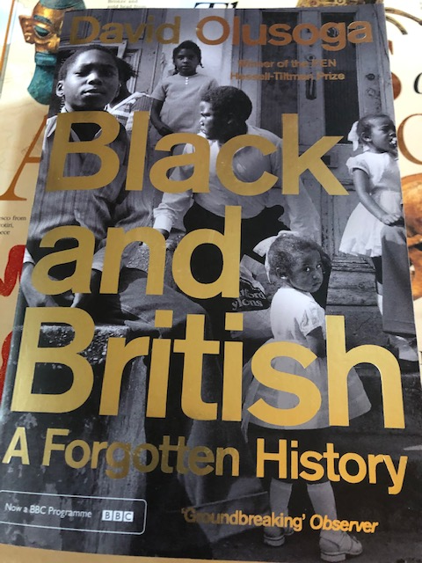
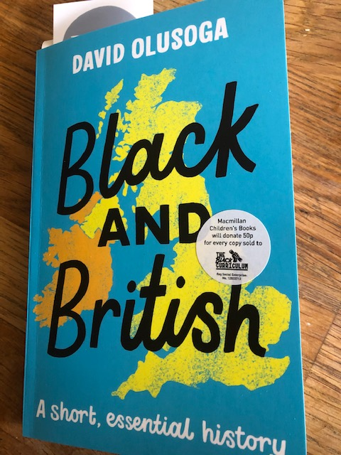

Slide 42
Diversity - criteria to use for your history policy
1. Ensure that teaching and learning about diversity is related to all aspects of ‘big-picture history’ including local, regional and British, European and world history from the distant to recent past.
2. Where appropriate, include gender, ethnicity, and social class, religion, different regions and localities, in order to gain an insight into the diversity of people’s experiences at different times in the past.
3. Examine gaps in the way in which textbooks and websites etc. reflect the diversity of people’s experiences at given times in the past.
4. Go beyond looking at significant people, specific groups or events to understand the diverse experiences of people during specific periods and events in the past.

Slide 43
Priorities for next time ….

