Slide 1
Humanities SL INSET Geography
November 2022
Kate Moorse

Slide 2
Introductions, plan for the afternoon
Welcome & introductions
How this session is going to work
Main foci
Co-ordinator role & Developments and issues
Embedding geographical concepts - EYFS > KS1 > KS2 :
‘similarity and difference’; ‘sense of place’; ‘environment’
Contrasting pupils’ worlds with environments further afield;
Developing locational and place knowledge from EY/KS1>year 6
What to do about fieldwork after more than two disrupted years.
What’s new? + ideas to share
Notes:
1.00 – 1.20 Introductions, plan for the afternoon.
Developments and issues in history (arising since March). Please be prepared to share with colleagues:
strategies adopted to support learning
recommended resources, websites etc.
implications for teaching and learning in the light of lost time and ongoing constraints
Ofsted & history
priorities for next year?
1.20 – 2.30 The role of co-ordinator or subject leader:
Thinking through PROGRESSION from EYFS (taking in the revised EYFS framework) to year 6
1. Developing and securing historical knowledge
mapping coverage – scope and scale
Ofsted and historical knowledge
Implications for the wider curriculum
Assessment opportunities
Anticipating the implications for teachers’ subject knowledge
What to do about chronological understanding after 2 disrupted years:-
Auditing current or planned provision
An enquiry-based framework
How best to use local history to support progression
Filling the gaps in experience
** (Please have curriculum plans, and any resources you use or have developed)
2.30 – 3.00 Jana Cameron – Learning Officer, Brent Museum and Archives
Opportunities offered by the local museum and archive service & news about upcoming events
Stuart Scott – Collaborative Learning Project
Collaborative Learning developments
http://www.collaborativelearning.org/workinprogress.html
http://www.collaborativelearning.org/londonhumanities.html
Future priorities??
2

Slide 3
Who’s here today? - 1
How long have you been subject leader for geography?
5 yrs +
1-5yrs
Less than one year
Just this term
Which key stages do you have responsibility for?
EYFS + KS1
KS1 only
KS2 only
KS 1 & 2
All key stages
Notes:
3

Slide 4
Who’s here today? - 2
When did your own geography education stop?
At 14
At 16 (GCSE)
At 18 (A’ level)
With a geography degree?
Do you have responsibility for history too?
Notes:
4

Slide 5
Bearing in mind the role of the subject leader in auditing provision….
Re-visiting planning and preparation with progression in mind EYFS>KS1>2
Building on pupils’ existing knowledge and anticipating future learning
Identifying what to assess and when
Implications for teachers’ subject knowledge.
Notes:
http://www.collaborativelearning.org/05assessment.pdf
HA – Jamie Byrom
http://www.collaborativelearning.org/04coordinator.pdf
Curriculum indicators (co-ordination)
5

Slide 6
… and given that ….
Ofsted is alive and well – and has survived the pandemic – so the emphasis is (happily) still on delivering the whole curriculum.
The 2+ years of covid will have meant that individual children and groups of children have had very variable access to the humanities and practical fieldwork.
What challenges face you in your role…. See slide 7
Notes:
6

Slide 7
Developments and issues in geography (arising over the last year) – group discussion
strategies adopted to support learning?
recommended resources, websites etc.
implications for teaching and learning in the light of lost time and ongoing constraints
Ofsted & geography (any recent experiences?)
priorities as subject leader?

Slide 8
Ofsted research review – GEOGRAPHY June 2021
https://www.gov.uk/government/publications/research-review-series-geography/research-review-series-geography

Slide 9
The report ……… (and its quite long – 32 pages but not as long as history’s 56!)
Outlines the national context in relation to geography
Considers curriculum progression in geography, pedagogy, assessment and the impact of school leaders’ decisions on provision
Summarises Ofsted’s review of research into factors that can affect quality of education in geography

Slide 10
Ofsted soundbites – May/June 2021
“Teaching geography in the early years was almost universally strong. Teachers were adept at helping pupils to understand their locality, the wider world and phenomena, such as the weather and seasons. Pupils with special educational needs and/or disabilities were fully included in the provision for geography. Teachers and other adults supported these pupils well so that they could access the same content.”

Slide 11
May/June 21 – Ofsted observations
“……. (some) teachers are not drawing out important geographical concepts or introducing errors. We found that pupils often struggled to recall places they had studied, including the principal cities of the United Kingdom and major world oceans. Very few showed a good appreciation of scale. Important geographical skills (using maps, atlases, globes and digital mapping, using locational and directional language, using aerial photographs, devising maps, using Ordnance Survey maps and fieldwork) were not taught particularly well. When pupils were constructing their own plans or maps, these often lacked the accuracy or conventions followed by geographers, such as the use of scale. In some schools, teachers were making good use of the plentiful supply of globes, atlases and maps at various scales. In others, this was less common.”

Slide 12
& on fieldwork ……
“Fieldwork is vital to geographical practice, but this was weak in key stage 2 in many of the schools we inspected. That’s not to say that pupils did not visit different places, but, when they did, they did not make the observations or collect data that they could analyse and present their findings. Fieldwork was much stronger in the early years and key stage 1”.

Slide 13
Re: KS2 & skills & fieldwork
Ofsted’s research in 2020 on geography in primary schools showed that most were revising their geography curriculum. Inspectors found that almost half of the schools inspected did not teach the breadth of knowledge set out in the national curriculum, particularly in key stage 2. Inspectors noted that pupils’ geographical skills were weak and there was a paucity of meaningful fieldwork. Nonetheless, pupils showed a healthy appetite for geography. They also displayed concern for the world and its people.

Slide 14
Re: early years and KS1
the ‘people, culture and communities’ and ‘natural world’ strands set out much clearer, identifiable geographical knowledge that children are to learn. In other strands, there are opportunities for children to draw on geographical content. For example, they may develop their fine-motor skills when drawing plans and sketch maps. Crucially, in the early years, children begin to acquire some of the geographical vocabulary that they will build on through the rest of their schooling.
…. helping pupils to understand their world, their role in it and the responsibilities that come with it.

Slide 15
Summary
Substantive knowledge sets out the content that is to be learned. The national curriculum and other geography education literature presents this through 4 interrelated forms:
locational knowledge
place knowledge
human and physical processes (the geography community also includes ‘environmental’ as part of this)
geographical skills.
Disciplinary knowledge considers how geographical knowledge originates and is revised. It is through disciplinary knowledge that pupils learn the practices of geographers.
A successful geography curriculum reflects teachers’ careful thought about what is to be taught, the rationale for it, the sequencing of learning and the relationships between the forms of knowledge. With this in place, pupils are likely to know, remember and be able to do more.

Slide 16
AIDE MEMOIRE

Slide 17
GEOGRAPHY @ KEY STAGE 1
LOCATION KNOWLEDGE
Name & identify characteristics of the 4 countries & capital cities of UK & the surrrounding seas
Name & locate the world’s 7 continents & 5 oceans
Identify the location of hot & cold areas of the world in relation to the Equator & North & South Poles
PLACE KNOWLEDGE
pupils should understand geographical similarities & differences through study of the human & physical geography of:
school & its grounds
surrounding locality
small area of UK
small area in a contrasting non-EU country

Slide 18
HUMAN & PHYSICAL GEOGRAPHY (themes to study in a place)
School & locality might include:
weather & seasons
hill, valley, river
city, town, house
factory, office, shop
In addition, small areas of UK & in a contrasting non-EU country also need to include:
beach, cliff, coast, sea, ocean
forest, vegetation
mountain
village, farm
port, harbour

Slide 19
GEOGRAPHICAL SKILLS & FIELDWORK (to use in studying themes in places)
Use simple fieldwork & observational skills to study the geography of the school and its grounds and key human & physical features of the surrounding locality
Use (photographs), aerial photographs & plan perspectives to recognise landmarks & basic human & physical features
Devise a simple map & use & construct basic symbols and a key
Use 4 compass directions (N S E W) and locational and directional language to describe features and routes on a map
Use world map, atlases & globes to identify UK and its countries and the countries & continents & oceans studied

Slide 20
GEOGRAPHY @ KEY STAGE 2
LOCATION KNOWLEDGE
Locate the world’s countries, using maps to focus on Europe (including the location of Russia) and North and South America, concentrating on their environmental regions, key physical and human characteristics, countries and major cities.
Name & locate counties & cities of the United Kingdom, geographical regions and their identifying human and physical characteristics, key topographical features (including hills, mountains, coasts and rivers) and land-use patterns and understand how some of these aspects have changed over time
Identify the position and significance of latitude, longitude, Equator, Northern Hemisphere, Southern Hemisphere, the Tropics of Cancer & Capricorn, Arctic & Antarctic Circles, the Prime/Greenwich Meridian and time zones (including day and night)

Slide 21
GEOGRAPHY @ KS 2
PLACE KNOWLEDGE
pupils should be taught to understand geographical similarities & differences through the study of human and physical geography of:
The local area (see skills section)
A region of the United Kingdom
A region in a European country
A region within North or South America

Slide 22
HUMAN AND PHYSICAL GEOGRAPHY - pupils should be taught to describe and understand key aspects of:
Physical geography including:
Climate Zones, biomes & vegetation belts
Rivers & mountains
Volcanoes & earthquakes
Water cycle
Human geography including:
Types of settlement & land use
Economic activity including trade links
Distribution of natural resources including energy, food, minerals & water

Slide 23
GEOGRAPHICAL SKILLS & FIELDWORK
Use fieldwork to observe, measure & record the human & physical features in the local area using a range of methods, including sketch maps, plans & graphs, and digital technologies
Use the eight points of a compass, four & six figure grid references, symbols and key (including the use of Ordnance Survey maps) to build their knowledge of the United Kingdom and the wider world
Use maps atlases, globes and digital/computer mapping to locate countries and describe features studied

Slide 24
High-quality geography education may have the following features (Ofsted)
The geography curriculum identifies sufficient breadth of content and ensures that pupils learn this in sufficient depth.
Pupils’ geographical education begins in the early years and builds year on year, developing pupils’ expertise.
The organisation of the curriculum builds knowledge so that pupils can draw on it in future learning. Pupils are increasingly able to apply generalisations to understand the world around them.
Teachers are the adjudicators of curriculum content and select it judiciously. They use their good subject knowledge to do this and take into account how pupils build their geographical knowledge over time.
Geographical expertise is built on substantive geographical knowledge. Drawing from the breadth of concepts gives pupils the knowledge they need to appreciate the whole domain of geography. They understand how common concepts draw different aspects of the subject together.
Teachers break down the content they wish pupils to learn into component parts. When selecting that content, teachers take into account what their pupils need based on their prior knowledge and experiences.

Slide 25
high-level concepts are central to a pupil’s geographical education…
These include:
place
space
scale
interdependence
physical and human processes
environmental impact
sustainable development
cultural awareness
cultural diversity

Slide 26
Locational Knowledge:high-quality geography education may have the following features (Ofsted)
Pupils gain a secure knowledge of distance, orientation, scale and positioning systems, which begins in the early years. This gives them the framework they need to understand locational knowledge.
‘Knowing where’s where’ supports pupils’ identity and sense of place and contributes to their understanding of geographical processes.
Over time, pupils learn and remember more locational knowledge. They become increasingly fluent in identifying specific locations.

Slide 27
PLACE: high-quality geography education may have the following features (Ofsted)
Place knowledge is prioritised in the geography curriculum. It brings meaning to locations and processes studied.
The curriculum and teachers’ plans build pupils’ knowledge of place by linking to places pupils already know or are familiar with. This may be from their personal experience as well as through what they have been taught.
The curriculum gives pupils the knowledge they need to develop an increasingly complex understanding of place. Their understanding of place helps them to connect different aspects of geography. It also gives them different perspectives through which to consider the content studied.
The curriculum builds pupils’ place knowledge over time. This allows them to make meaningful comparisons.

Slide 28
Environmental, physical and human geography: high-quality geography education may have the following features (Ofsted)
Increasingly detailed knowledge of physical and human processes allows pupils to describe and explain different environments. Through this, pupils develop an appreciation of interconnectedness.
Component knowledge is identified precisely and sequenced so that pupils first learn underpinning phenomena before moving on to more complex, multi-variate processes. This allows pupils to fully understand a wide range of environmental, human and physical processes.
Over the course of study, pupils learn about processes that they are less familiar with or that are less visible.
The curriculum ensures that older pupils are able to take a broader view, generalise, and critique models that represent specific processes.

Slide 29
Geographical skills and fieldwork: high-quality geography education may have the following features (Ofsted)
Pupils’ procedural knowledge (geographical skills) allows them to gather, analyse, present and interpret spatial information. In doing so, they are adept at identifying patterns and trends.
Pupils have the specific skills they need to represent and interpret geographical data. These skills are integrated into the curriculum so that pupils understand their application.
Repeated practice of geographical skills improves pupils’ fluency and accuracy.
Fieldwork includes data collection, analysis and presentation. The experience of fieldwork draws together pupils’ locational knowledge and that of human and physical processes. It supports pupils to appreciate the interplay between them.

Slide 30
Geographical skills and fieldwork
The procedural knowledge, generally called ‘geographical skills’, includes the knowledge necessary to carry out fieldwork.
Geographical skills allow pupils to collect, represent and interpret spatial information and their acquisition is an important dimension of the geography curriculum.
Fieldwork
Geographical skills
Map skills - decoding information from maps; constructing (or encoding) maps; analysing distributions and relationships; route-finding; interpreting the information to draw conclusions
Aerial photography & satellite imagery
Geographic information systems (GIS)

Slide 31
Summary
The geography curriculum in schools identifies the knowledge and skills that pupils are to learn. Like many subjects, knowledge in geography can be organized into 2 forms:
Substantive knowledge sets out the content that is to be learned….
Locational knowledge
Place knowledge
Human and physical processes (incl. environmental)
Geographical skills
Disciplinary knowledge considers how geographical knowledge originates and is revised. It is through disciplinary knowledge that pupils learn the practices of geographers

Slide 32
Creating a need to know
hypothesising, asking questions, planning enquiry
Reflecting on learning
Evaluating, identifying areas for improvement, further questions?
ENQUIRY FRAMEWORK
(M. Roberts)
Using resources
locating & selecting evidence; collecting, sorting, classifying
Making sense
describing, explaining , analysing, concluding

Slide 33
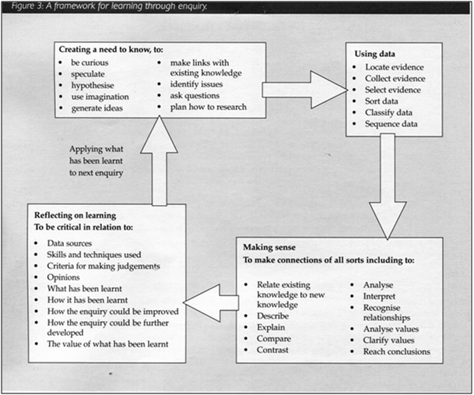

Slide 34
Enquiry (Ofsted): high-quality geography education may have the following features
Pupils are proficient in carrying out enquiries and decision-making exercises because they are secure in the prior knowledge they need for these.
Carefully structured tasks give pupils sufficient instruction, guidance and support.
The enquiry approach supports the development of pupils’ disciplinary knowledge. For example, it increases their capacity to recognise and ask geographical questions, and to critique sources and reflect on what they have learned, as well as the methods used.

Slide 35
GEOGRAPHICAL ENQUIRY - SOME QUESTIONS (These are focused on understanding places, changes that occur and ways in which people both affect and are affected by the features being studied)
What is it ?
Where is it?
What is it like?
What is it about?
How did it get like this?
How and why dad it happen?
What processes are involved?
With what effect?
What might happen?
With what impacts?
What decisions will be made?
With what consequences?
What so people think and feel about this?
What do I think and feel about this?
What next? Enquiry about a locality
What is this place like?
Why is it like this?
How is it connected to other places?
How has it changed?
What does it feel like to be there?
Where is this place?
What does it look like?
What are the main features of the landscape?
Do many or few people live there?
What do people do in this place?
Do many people visit this place? Why?
How is it similar or different from our home area?

Slide 36
Questions to reflect on as SL …….
Different types of stimulus?
What are good enquiry questions that have both ‘pith and rigour’?
Does the presence of a question as a lesson heading mean it must be an enquiry approach?
Why is it important for pupils to create their own questions? What strategies can a teacher use to get pupils to ask questions?
Examples you have experienced of a teacher adopting a particular ‘stance’ to promote curiosity. How did it work? What stances could be successful for particular topics?
What type of outcomes can be particularly good motivators for enquiries?

Slide 37
Here’s where concepts come in…..
There is a need to identify both the content (substantive knowledge) that is to be taught and the knowledge of relationships that allow pupils to understand the connections between ideas (disciplinary knowledge). Pupils’ combined appreciation of both substantive and disciplinary knowledge can be described as geographical understanding.

Slide 39
The ‘big’ (threshold) concepts in geography providing an underlying structure for progression
Place
Scale
Interdependence
Physical and human processes
Environmental interaction & sustainable development
Cultural understanding
Diversity

Slide 41
Environmental impact (organizing or ‘big’ concept)
http://www.collaborativelearning.org/londonhumanitiescurrentinset.html
http://www.collaborativelearning.org/12planning.pdf (topical issue)

Slide 42
Environment
We use the term ‘environment’ in two main ways:-
the surroundings in which an individual or community functions.
different types of environment, each of which has a characteristic combination of features, conditions and processes which are interrelated, often in complex ways.
How environments function is an important focus in both physical and human geography. A useful distinction can be made between natural environments and environments which have been modified or, to a large extent, created by human activities. Most large-scale environments have been affected to some extent by human beings, either directly or indirectly.

Slide 43
From the early years on, the curriculum should set out how pupils gain knowledge of environmental, human and physical processes so that pupils can:
describe their own and others’ environments
recognise the similarities and differences between the world around them and contrasting environments
understand important processes and changes in the world around them, including those affecting the land, bodies of water and the air, people, and wildlife

Slide 44
What is an ecosystem?
Sun
Ecosystem
Flora+ Fauna
Climate
Environment
Animals
Air
Soil
Water

Slide 45
What does the data show?
What is the data showing – what is the weather like?
What patterns can you see?
How would you describe the climate?
What might the effects on the environment be? What might the area look like?

Slide 46
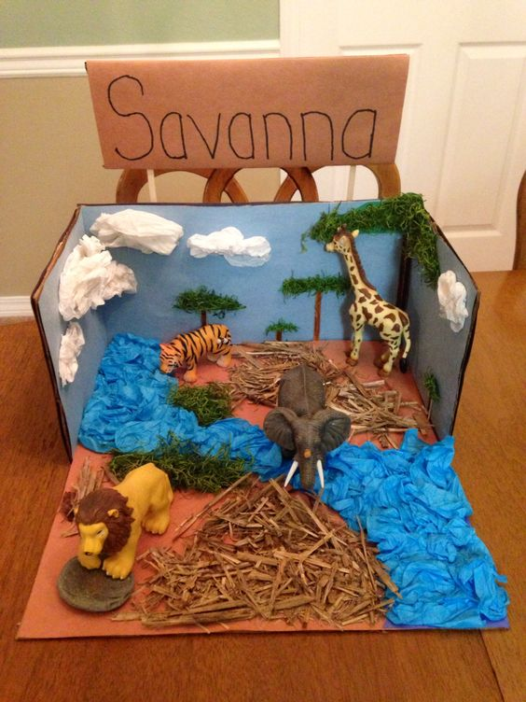
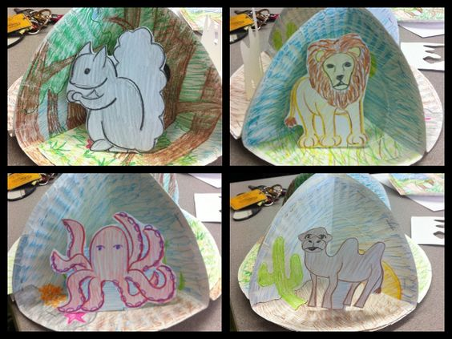

Slide 48
Taking water as our theme
Scoping possible contexts from EY – yr 6 & mapping concepts and links

Slide 49
An example of everyday knowledge: some matters to consider
Rivers – what they are, how we use them
The nature and purpose of rivers and their water on our planet.
How streams and rivers run from source to mouth – and why.
Why erosion, transportation and deposition are key aspects of rivers.
The roles of tributaries, meanders, waterfalls and other river features.
Fresh water and tidal reach – and what they may be used for.
The erosion of wide valleys and narrow gorges – and their effects.
The names, locations, routes and roles of major rivers around the World.
The uses rivers are put to, why, by whom and with what effect.
How rivers support and undercut environments, people and places.
The effects of rivers losing water or having too much, or of being polluted.
Ways in which people ‘adjust’ and use rivers, and the effects of this.
Place…location…scale…connectedness…human/physical processes …human & environmental impact…
What experiences (and when) of rivers have children had (or will need) previously? What is implied if a child has never seen a stream or river?
Why might children think rivers can flow uphill?

Slide 50
The Colne Valley Regional Park – a fantastic local resource – water, water everywhere! https://www.colnevalleypark.org.uk/
A mosaic of farmland, woodland & water with 200 km of rivers, canals, reservoirs and over 60 lakes
The Colne Valley Regional Park, formed in 1965 , stretches from Rickmansworth in the north, to Staines and the Thames in the south, Uxbridge and Heathrow in the east, to Slough and Chalfont in the west. Covering 43 square miles the landscape is a mix of bustling towns, green spaces and waterways which are the first taste of countryside immediately west of London.

Slide 51
CV links
https://www.colnevalleypark.org.uk/wp-content/uploads/2020/01/CVP-Visitor-Guide-2020.pdf
https://www.colnevalleypark.org.uk/places-to-go/
Gallery - Colne Valley (colnevalleypark.org.uk) – fabulous sets of photos on different aspects of the park and activities

Slide 53
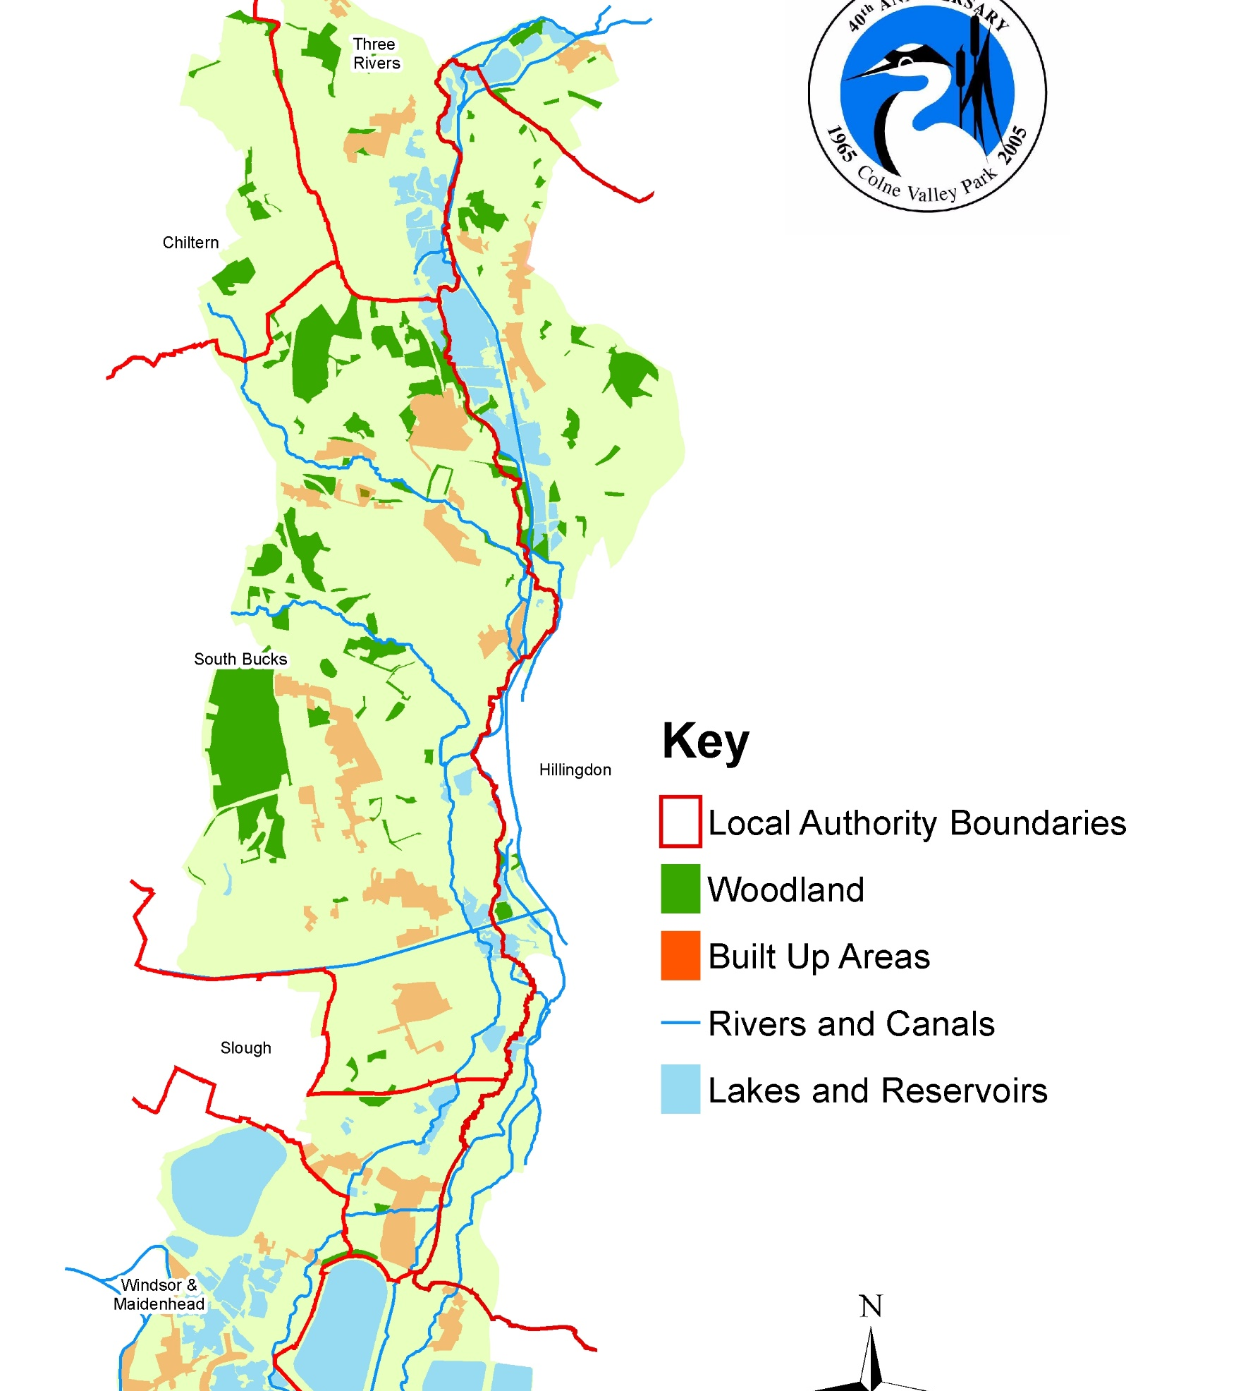
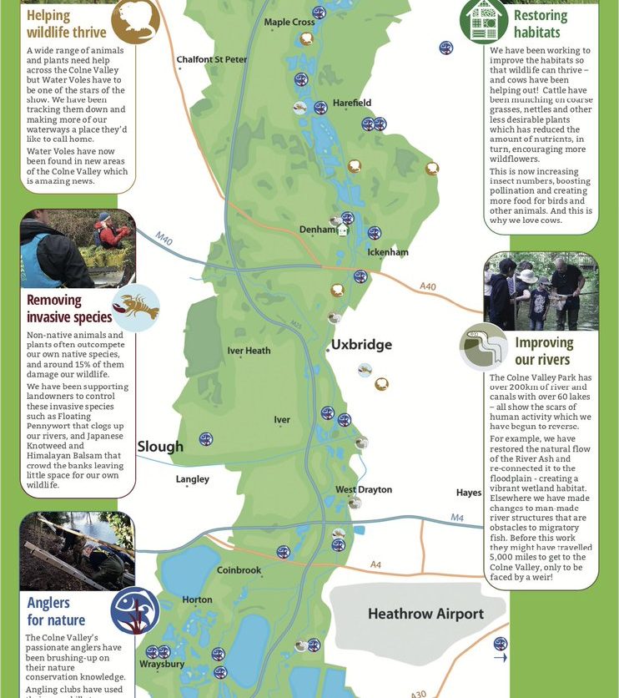

Slide 54
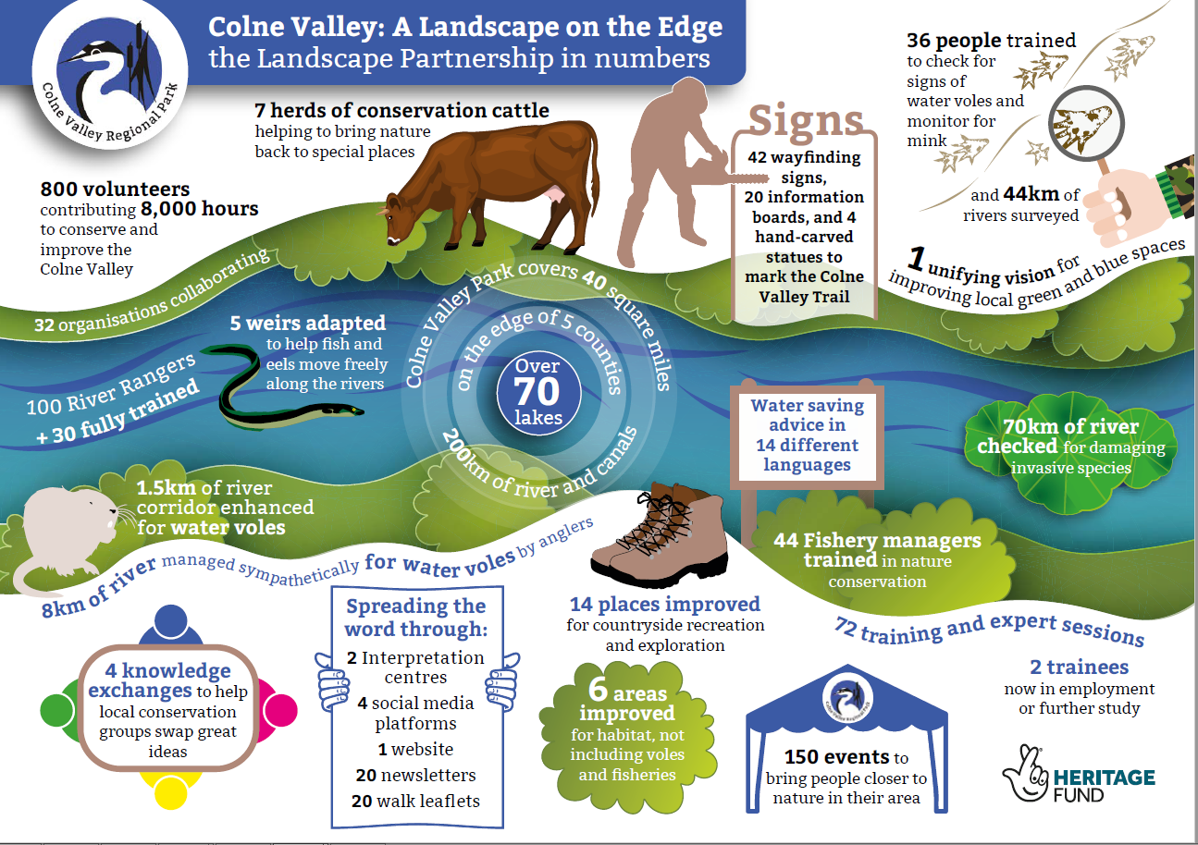

Slide 55
Harmondsworth Moor

Slide 56
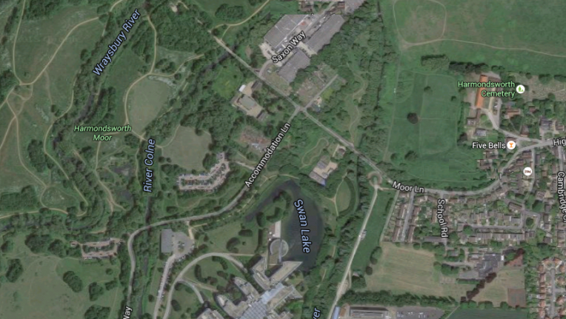

Slide 57
Water on the moor
Flowing across Harmondsworth Moor are at least 3 watercourses – the River Colne, the Wraysbury and the Duke of Northumberland’s river. Add to these, the Grand Union Canal together with the lakes created by gravel extraction and you have lots of ways to compare and contrast the watery aspects of this ‘place’.

Slide 58
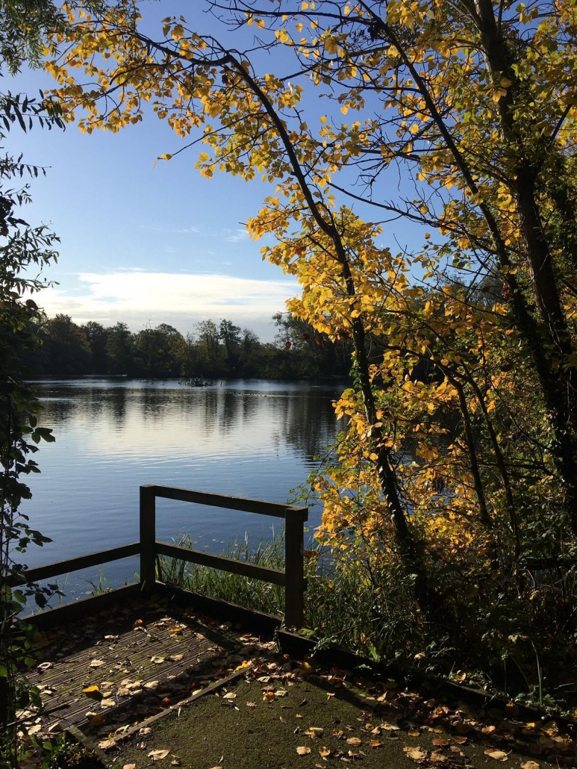
There are 70 lakes in the Colne Valley Park
How are lakes different to rivers?
How are they the same (or similar)?
How have they been formed?
There are also reservoirs – why are they so important? What is their function?

Slide 59
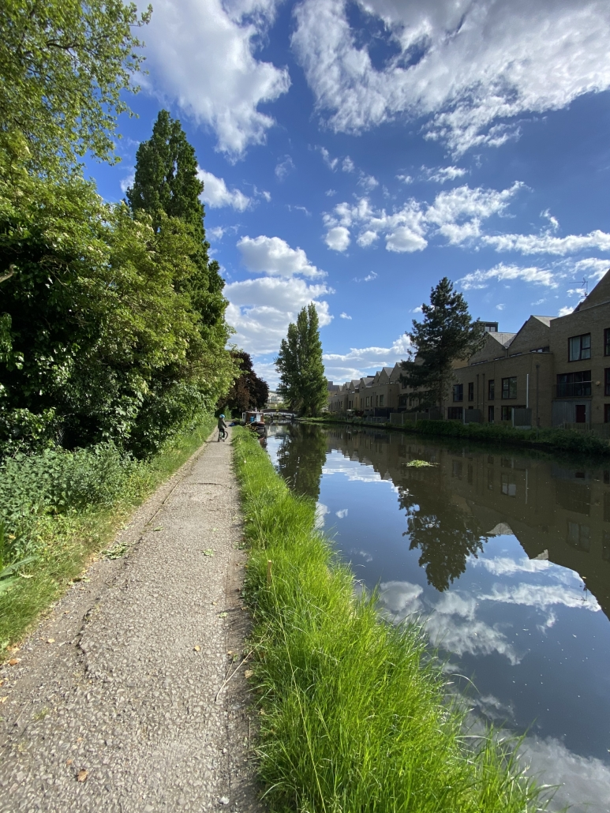
Grand Union Canal
What tells you this is not a river? (similarity & difference)
What specialist vocabulary would you point up?

Slide 60
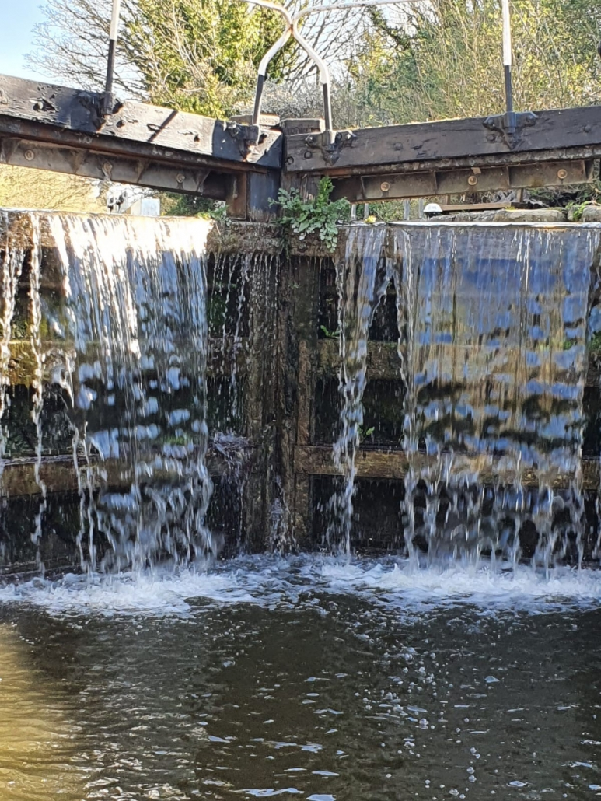
Hooks and Potential studies
What questions arise from these photos?
Where might an enquiry take you?
What foci of study may follow?

Slide 61
Flora and fauna – curriculum links?

Slide 62
SEASONS? – detecting the clues

Slide 63
And here?

Slide 64
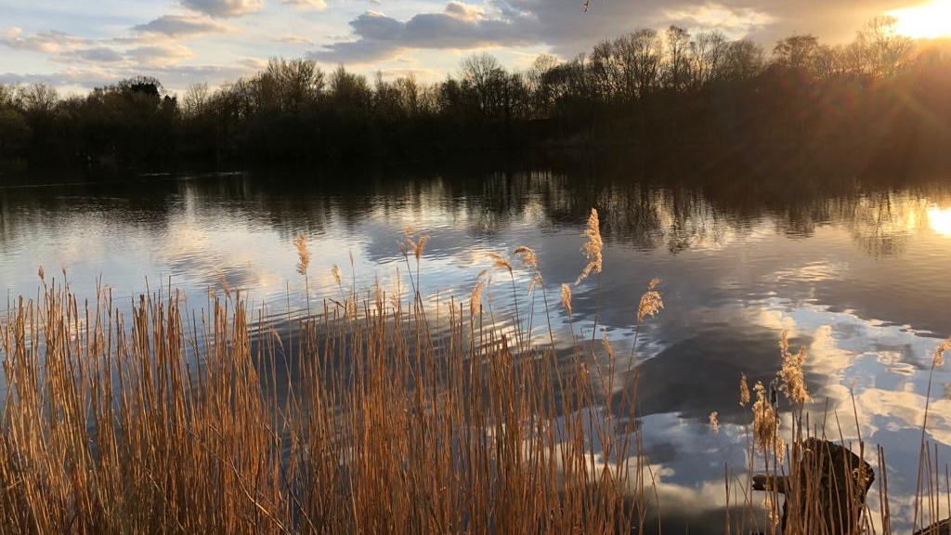

Slide 65
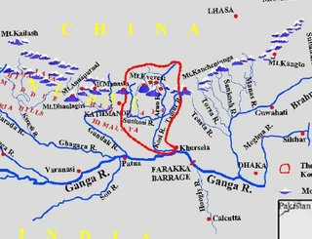
Contrasting location & river system http://www.collaborativelearning.org/rivergangesinfogap.pdf
Where is this place?
What is it like?
How is it different from ‘my place’ and ‘my river’?
In what ways is it the same?

Slide 66
When and where will you seed the knowledge that pupils need to get the most from a river study? What is that knowledge?
Geographical vocabulary
Water cycle
Features of rivers and other water courses
Natural environments
Built environment
Human ‘needs’
Adaptations of rivers and their purposes
Etc. etc.???

Slide 67
CL links: water related
http://www.collaborativelearning.org/journeytoriverseac4.pdf
http://www.collaborativelearning.org/kapitiplain.pdf
http://www.collaborativelearning.org/coastdominoes.pdf
http://www.collaborativelearning.org/glaciersdominoes.pdf
http://www.collaborativelearning.org/seacoastormountains.pdf
http://www.collaborativelearning.org/extremeweatherc4.pdf
http://www.collaborativelearning.org/postcardsfromabroad.pdf
http://www.collaborativelearning.org/weatherconnectfour.pdf
http://www.collaborativelearning.org/rivergangesinfogap.pdf

Slide 68
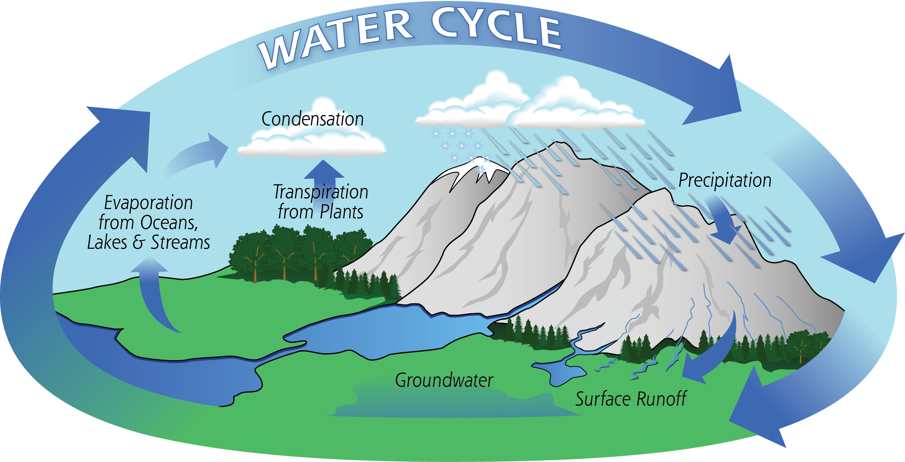

Slide 69
In the early years and key stage 1 …….
Children associate geographical features or processes with the language used to describe them so, for example, - pupils need to first learn the vocabulary associated with describing the weather, often gained through activities that require them to observe the elements of weather (precipitation, wind, temperature etc.). Subsequently pupils will recall this knowledge to learn that certain combinations of weather relate to the seasons.
From here, the curriculum can begin to build a geographical knowledge of where these conditions are typically found through learning about climate belts and later study into biomes.

Slide 70
What next?
Key stage 1?
(early) key stage 2?
(late) key stage 2?

Slide 71
Three aspects of pupils’ achievements in geography
The GA has identified these three aspects of achievement in geography:
Contextual world knowledge of locations, places and geographical features.
Understanding of the conditions, processes and interactions that explain geographical features, distribution patterns, and changes over time and space.
Competence in geographical enquiry, and the application of skills in observing, collecting, analysing, evaluating and communicating geographical information.
Notes:
What we want learners to achieve in geography is founded in the discipline.
These three fundamental aspects of achievement thread through the curriculum, so underpin progression. Together, they show how learners’ geographical thought and capability develop. They also make up the big objectives for geography: geographical knowledge, understanding and skills, which apply across the age range.
Although classifying learning and achievement is helpful, in practice, it may be difficult to distinguish between these three aspects – for example between knowledge and understanding.
These benchmarks aren’t necessarily things you’d share with your pupils, as they’re abstract and related to professional knowledge.

Slide 72
Three dimensions of progress: what does it mean to get better in geography?
For the three aspects of achievement, we have identified these five dimensions of progress in geography:
Contextual world knowledge
Demonstrating greater fluency with world knowledge by drawing on increasing breadth and depth of content and contexts.
Understanding
Extending from the familiar and concrete to the unfamiliar and abstract.
Making greater sense of the world by organising and connecting information and ideas about people, places, processes and environments.
Working with more complex information about the world, including the relevance of people’s attitudes, values and beliefs.
Geographical enquiry and skills
Increasing the range and accuracy of pupils’ investigative skills, and advancing their ability to select and apply these with increasing independence to geographical enquiry.
Notes:
What does it mean to get better at geography – and how will we recognise it in pupils’ work? These dimensions add a sense of progress to each of the three aspects of achievement in the previous slide.

Slide 74
Where do people live in Andalucia? – which are the main settlements & why? What are the houses like? Why? | To locate cities, towns, ports & villages etc. About similarities & differences To begin to understand the relationship between climate, local materials and the built environment To appreciate the part that history plays |  | Map cities, main towns and tourist centres Awareness of less populated areas e.g. agricultural or mountainous areas Appreciate the traditions that have produced a distinctive architecture |  | Prrovinces, Seville (capital), ranada, Malaga, Cordoba ....et al Historical significance - Arab/Moorish + Christian heritages Transport hub Coastal + mountain tourism
How is Andalucia connected to other places? ...... in Spain & Portugal? ...........in Europe? ...... The world? How would you get about in Andalucia? | How places relate to one another About similarities & differences between places How physical features shape transport routes |  | Ability to plan/trace routes between places Understand the role & importance of transport links for the economy, communications and everyday life |  | Borders/frontiers Transport links – motorways, roads, rail, air, sea
What issues currently face people living in Andalucia? | To consider one or more issues in context |  | That people’s concerns change over time and depend on a variety of factors. |  | E.g. …Economic downturn & shortage of jobs Renewable energy Demographic change
Do we think we would like it in this part of Southern Spain? Do we want to go there? | To make individual/group assessment or come to a view based on evidence encountered through enquiry |  | Appreciate diverse points of view. The value of making informed judgements |  | Evidence, ‘informed’ judgement or view

Slide 75
Possible contexts moving out from the local opportunities for contrasting ‘places’
There are several ‘Colne’ rivers in the UK, e.g. the River Colne in Essex flows through Colchester & into the North Sea – a comparison of ‘places’??
Also Colnes in West Yorkshire – and Lancashire!
______________________________________
Thames
Andalusian rivers e.g Guadalquivir (flows into Atlantic), Andarax/Almeria (flows into Mediterranean)
Amazon
Ganges

Slide 76
Using a topical event or issue as a hook….. e.g. COP27
What has been in the news recently?
Where was it happening?
Why now?
What does it mean for us?

Slide 77
Collaborative Learning Project
www.collaborativelearning.org
And for the dedicated page for London humanities teachers:
http://www.collaborativelearning.org/londonhumanities.html

Slide 78
Useful supplementary slides

Slide 79
Some useful CL activities to support rain forests, climate change & related issues
http://www.collaborativelearning.org/rainforestvocabulary.pdf
http://www.collaborativelearning.org/rainforestphotosortinfogap.pdf
http://www.collaborativelearning.org/rainforestintroduceme.pdf
http://www.collaborativelearning.org/rovingrainforestreporters.pdf
http://www.collaborativelearning.org/palmoil.pdf
http://www.collaborativelearning.org/animallifestyles.pdf
http://www.collaborativelearning.org/practicalaction.pdf
http://www.collaborativelearning.org/whatcanyougrow.pdf
http://www.collaborativelearning.org/extremeweatherc4.pdf

Slide 80
Global Learning Programme now ….. Connecting Classrooms – resources:
British Council | Connecting Classrooms
Schools connect - Partner with a school – UK or overseas
Climate resources
Around the world – resources about culture around the world

Slide 81
Purpose of study – Gg (NC)
A high quality geography education should inspire in pupils a curiosity and fascination about the world and its people that will remain with them for the rest of their lives. Teaching should equip pupils with knowledge about diverse places, people, resources and natural and human environments, together with a deep understanding of the Earth’s key physical and human processes. As pupils progress, their growing knowledge about the world should help them to deepen their understanding of the interaction between physical and human processes, and of the formation and use of landscapes and environments. Geographical knowledge, understanding and skills provide the frameworks and approaches that explain how the Earth’s features at different scales are shaped, interconnected and change over time .

Slide 82
Global Learning Programme – curriculum framework
better understand their role in a globally-interdependent world and to explore strategies by which they can make it more just and sustainable;
become more familiar with the concepts of interdependence, development, globalisation and sustainability;
move from a charity mentality to a social justice mentality;
gain greater awareness of poverty and sustainability
think critically about global issues
explore alternative models of development and sustainability
and consider the relative merits of different approaches to reducing global poverty and draw conclusions about the causes of global poverty and how it can be addressed.

Slide 83
The geography NC content which primary teachers might know to teach geography.
The school’s neighbourhood and community, and the wider area.
A wide variety of physical and human environments and their features.
Non-European, contrasting localities, including how to compare these.
Different regions in the UK and Europe, in South/North America, including their physical and human geographies and characteristics and how to compare these.
Weather, seasons, climate zones, and biomes and vegetation belts.
The water cycle, rivers, hills, valleys, mountains, earthquakes and volcanoes.
Homes, shops, businesses, parks, etc. and patterns in settlements and land use.
Economic activities, trade, key services and resources: water, energy, minerals.
The location of the key features of the Earth, from continents and oceans to seas, mountains, deserts and rivers, to countries and cities.
Caring for, improving and sustaining our local/global places and environments.
A good range of geographical vocabulary, both ‘everyday’ and technical.
Map and aerial photograph reading and interpretation, using using essential maps skills with atlas, Ordnance survey and digital maps, and map making.
Investigating, undertaking fieldwork, using various methods of observing and measuring and various ways for recording and communicating findings.

Slide 84
Dr Ian Cook’s ‘Follow the things….’ www.followthethings.com
Choose a ‘thing’: one of the ‘things’ used in everyday life: e.g. milk, electricity, tap water, a laptop, your trainers, scissors, a recycled bag, a ‘reading’ book, a TV series, the pavement, CCTV camera, a bunch of flowers, a ‘take away’ meal ….
Personal or others’ use: Why used? Who by? What for? How? When? Where?
Describe: How do you obtain or notice it? What is it like? What it is ‘made of’? Is it a necessity or for pleasure?
Enquire: How is it made/created? Where and by whom? With what resources? Where are the resources from? Who generates and transports the them? How is this done? From and to where? Why there? What distances are travelled, the sequence, for how long? How is it marketed and sold? Where and why? What does ‘it’ cost? Who gets what share?
Explain: What are the impacts of producing the resources and the chain of ‘production’? How interdependent and cross-national? What does production, at all stages, do for people? At what cost? In what sort of working conditions? Is it produced ethically? Is it ‘sold’ ethically? Is it used ethically?
Evaluate: What is their life like, as unskilled and skilled labourers, managers or owners, as workers and in life outside work? What options do they have? What are their views? What is fair or unfair about it? How equal? Can it change?
Opinion: What is your view? Will you continue to use ‘it’? Why? What changes might you make?
Place…location…scale…connectedness…human/physical processes …human/environmental impact…

