Slide 1
Ofsted update
November 2019
Kate Moorse

Slide 2
Focus – section 8(i)
always consider and evaluate all aspects of the aims of the school’s curriculum, including the degree to which the school’s overall curriculum is coherently sequenced and structured
consider the extent to which teachers have good knowledge of the subjects they teach, present subject matter clearly, check pupils’ understanding systematically, identify misconceptions accurately and provide clear, direct feedback to pupils
consider the extent to which pupils develop detailed knowledge and skills across the curriculum and, as a result, achieve well and are ready for the next stage of education, employment or training

Slide 3
Focus – section 8
quality of education
safeguarding
‘spotlights’ on behaviour / bullying, gaming/ off-rolling, staff workload and protection from bullying and harassment

Slide 4
Focus – section 8(ii)
explore how well a broad range of subjects (exemplified by the national curriculum) is taught in key stage 2. Inspectors will focus first and foremost on the teaching of reading, particularly on how children gain access to the whole of the national curriculum through learning to read fluently and with comprehension
Inspectors will gather evidence about the implementation of the curriculum so that they can form a view about the degree to which series of lessons follow the curriculum intent of the school. They will also look at the degree to which these series of lessons are well sequenced within the intended curriculum and how well they provide purposeful opportunities for pupils’ progression through it.

Slide 5
Section 8 personal development
Inspectors will consider the extent to which the curriculum goes beyond the academic, vocational or technical, whether the school provides effectively for pupils’ broader development and whether the school’s work to enhance pupils’ spiritual, moral, social and cultural development is of a high quality.
Inspectors will not make a judgement on the criteria contained in the ‘personal development’ judgement.

Slide 6
Section 8 workload
Inspectors will consider the extent to which leaders engage with staff and are aware and take account of the main pressures on them, engaging with them realistically and constructively. They will consider the extent to which staff are free from bullying and harassment. Inspectors will also consider whether leaders and staff understand the limitations of assessment and use it in a way that will avoid creating unnecessary burdens

Slide 7
How do leaders ensure pupils can remember the curriculum long term?
Does the curriculum remain as broad as possible for as long as possible?
What does the school want pupils to learn and why?
How is this put into practice in the school curriculum planning?

Slide 8
Consider your responses…

Slide 10
Phone call part 1 – some questions to think about (i)
Give me the big picture of your curriculum. Where has it come from and what do you want it to achieve?
How do you ensure that pupils achieve their very best in each subject?
Tell me how you ensure that teachers can challenge and extend learning in all subjects?
How is learning sequenced over time in [subject]?
Who leads [subject] and what training have your staff in [key stage] had?

Slide 11
Phone call part 1 – some questions to think about (ii)
Tell me about your work to improve leadership.
Can you give me an example of the mapping in [subject]?
Do you have the same quality of leadership and sequences of learning in say, [subject and subject]?
So, how do teachers know what pupils need to know, and be able to do, by the end of the year?
So, how do teachers know what the key concepts are that children need to learn in order to do the things you want by the end of the year?

Slide 12
How ready are you to discuss the curriculum in this way?
What actions do you need to take to prepare for this?

Slide 13


Slide 15
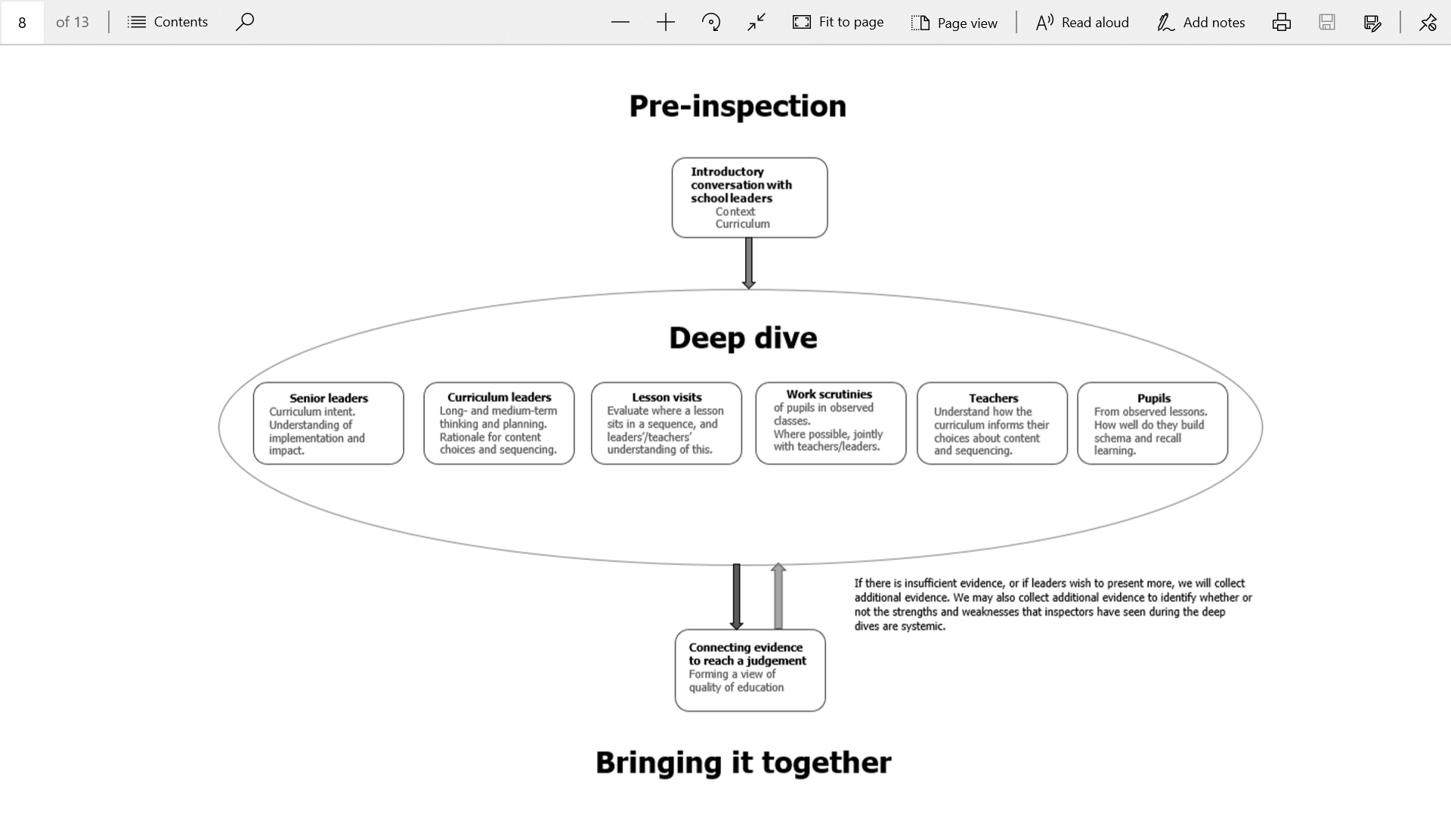
Deep dives
Notes:
The total number of deep dives will vary depending on the size) of the inspection.

Slide 16
Notes:
Always a deep dive in reading and deep dives in one or more foundation subjects, always including a foundation subject that is being taught in the school during the time that inspectors are on-site
Often a deep dive in mathematics
The total number of deep dives will vary depending on the size) of the inspection.
evaluation of senior leaders’ intent for the curriculum in this subject or area, and their understanding of its implementation and impact
evaluation of curriculum leaders’ long- and medium-term thinking and planning, including the rationale for content choices and curriculum sequencing
visits to a deliberately and explicitly connected sample of lessons
work scrutiny of books or other kinds of work produced by pupils who are part of classes that have also been (or will also be) observed by inspectors
discussion with teachers to understand how the curriculum informs their choices about content and sequencing to support effective learning
discussions with a group of pupils from the lessons observed.

Slide 17
Ofsted Inspection Handbook 2019: ‘Deep Dives’
Curriculum themed meetings with subject leaders, staff & pupils
Learning walk to see teachers across years groups, speaking to pupils and staff about stretch, challenge and knowledge coverage.
Scrutiny of curriculum mapping and pupil outcomes to see the curriculum mapping in action .
Talk to me about the deliberate action you have taken to shape the curriculum.
Talk to me about timetabling and coverage of the subject
Do all groups have access to the curriculum? How do you know?
What is the impact of staff training on staff subject knowledge and expertise?

Slide 19
Deep dives
‘It’s not about making judgements, it’s about asking questions’
Focus on intent choice & sequencing, focus on appropriate pedagogy not general pedagogy
Focus on - do pupils know more and remember more rather than the old concept of progress
Work scrutiny is not about judging progress but is about seeing what the planned curriculum looks like in practice or how successfully the curriculum has been enacted.
Is the stated curriculum evident in books? Are pupils drawing on a wide range of prior knowledge? A unit of learning is a sequence of lessons not an individual lesson.

Slide 20
Deep Dives – context matters
Inspectors need to know the purpose of the lesson (or the task in a workbook), how it fits into a sequence of lessons over time, and what pupils already know and understand.
Notes:
Carrying out lesson visits or work scrutiny without context will limit validity.
Conversations with teachers and subject leads can provide this contextual information. “Seeing the same learners through different lenses”

Slide 21
Deep Dives (CPD)
How are teachers supported to develop their subject knowledge alongside their pedagogical knowledge?
How are teachers supported to teach the component knowledge leading to NC outcomes
Inspectors to ask specific questions related to the school curriculum content or ‘give me an examples of something that is a taught in Y2 that is built on in Y4 and Y6?
How have you built on learning in Y3 in Y5?

Slide 22
Deep Dives – work scrutiny
Work scrutiny will form a part of the evidence we use to judge whether the intended curriculum is being enacted.
Do the pupils’ books support other evidence that what the school set out to teach has, indeed, been covered?
Work scrutinies can provide part of the evidence to show whether pupils know more, remember more and can do more, but only as one component of the deep dive which includes lesson visits and conversations with leaders, teachers and pupils.
Coverage is a prerequisite for learning, but simply having covered a part of the curriculum does not in itself indicate that pupils know or remember more. Work scrutinies cannot be used to demonstrate that an individual pupil is working ‘at the expected standard’ or similar, and it is not valid to attempt to judge an individual pupil’s individual progress by comparing books from that pupil at two points in time.

Slide 23
Deep Dives – work scrutiny

Slide 24
Work Scrutiny
Progress is defined as “knowing more, remembering more”
Inspectors will be referencing the NC more to evaluate content
There will be consideration of appropriate content choices, depth of content and sequencing across the curriculum
e.g. Can this progression be seen from the Early Years through KS1,2 and from Yr7 through to 6th Form?
Ofsted Inspection Handbook 2019

Slide 25
Workbook scrutiny: Ensuring validity and reliability in inspections June 2019

Slide 26
Workbook scrutiny: Ensuring validity and reliability in inspections June 2019

Slide 27
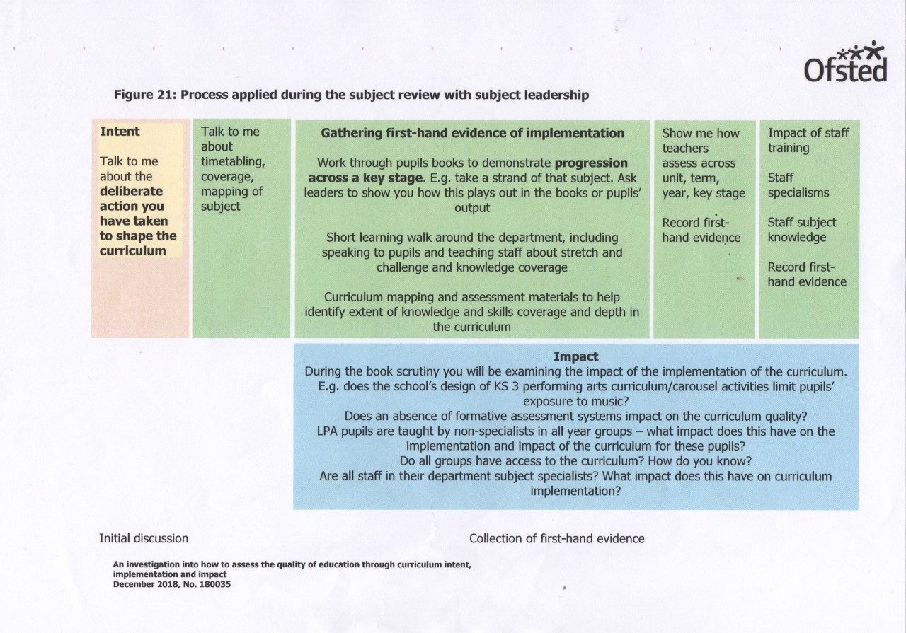

Slide 29

The Quality of Education
Intent: the way the curriculum sets out the knowledge and skills that pupils will gain at each stage
Implementation: the way the curriculum developed or adopted by the school is taught and assessed
Impact: the outcomes pupils achieve as a result of the education they have received
How do leaders judge the QoE?
How do they know?

Slide 30
Mythbuster – curriculum intent
Intent is about what leaders intend pupils to learn. Good intent, according to the Ofsted handbook, has the following features:
a curriculum that is ambitious for all pupils
a curriculum that is coherently planned and sequenced
a curriculum that is successfully adapted, designed and developed for pupils with special educational needs and/or disabilities
a curriculum that is broad and balanced for all pupils
Intent is all the curriculum planning that happens before a teacher teaches the knowledge that pupils need to learn the next thing in the curriculum
So, intent is nothing new. There’s no need to write new statements, adapt websites or restructure staffing to cover intent. Intent is not the next big thing.

Slide 31
Curriculum Design-Quality of Education-’Intent’
Leaders adopt or construct a curriculum that is ambitious and designed to give all pupils, particularly disadvantaged pupils and including pupils with SEND, the knowledge and cultural capital they need to succeed in life. This is either the national curriculum or a curriculum of comparable breadth and ambition.
The school’s curriculum is coherently planned and sequenced towards cumulatively sufficient knowledge and skills for future learning and employment
The curriculum is successfully adapted, designed or developed to be ambitious and meet the needs of pupils with SEND, developing their knowledge, skills and abilities to apply what they know and can do with increasing fluency and independence.
Pupils study the full curriculum; it is not narrowed. In primary schools, a broad range of subjects (exemplified by the national curriculum) is taught in key stage 2 throughout each and all of Y3-Y6.
Notes:
[If this is not yet fully the case, it is clear from leaders’ actions that they are in the process of bringing this about.]

Slide 32
In a nutshell– curriculum intent
In evaluating the school’s educational intent, inspectors will primarily consider the curriculum leadership provided by senior, subject and curriculum leaders.
Inspectors will talk to senior leaders to find out whether the curriculum is broad and balanced.
Is it at least as ambitious as the national curriculum?
Does it contain the right knowledge in the right order? Is the curriculum providing pupils with the building blocks of what they need to know and be able to do to succeed in each subject?
Notes:
So, when we’re talking about intent, we’re talking about how ambitious, coherently planned and sequenced, how broad and balanced and inclusive the curriculum is. That’s all in a school’s curriculum planning, up until the point that a teacher teaches the curriculum.

Slide 33
In a nutshell– curriculum intent
To what extent do leaders understand that the ‘curriculum is the progression model’?
What does the school want pupils to learn and why?
How is this put into practice in the school curriculum planning?
EYFS to KS2 – how do teachers know what to teach and when to teach it?
Appropriate content choices and sequencing. Depth of content & sequencing across the key stages. Can this progression be seen from the Early Years through KS1 and KS2.
Inspectors will be referencing the NC more.
Notes:
So, when we’re talking about intent, we’re talking about how ambitious, coherently planned and sequenced, how broad and balanced and inclusive the curriculum is. That’s all in a school’s curriculum planning, up until the point that a teacher teaches the curriculum.

Slide 35
Teaching-The Quality of Education-’Implementation’
Teachers have expert knowledge of the subjects they teach
Teachers enable pupils to understand key concepts, check for understanding systematically, ensure pupils embed key concepts
Are pupils making progress in lessons? What about all groups, particularly disadvantaged, most able and SEND
Teachers use assessment to check pupils’ understanding in order to inform teaching.

Slide 36
Quality of Education
To Consider:
Learning through pupils’ eyes; do they really know what they’re learning and and why they are leaning. What evidence demonstrates this?
How do teachers make sure knowledge ‘sticks’?
Are children making progress in lessons? What about all groups, particularly, disadvantaged and SEND?
Is learning behaviour/are attitudes strong?
Do resources maximise progress (including support staff)?
How skilled and knowledgeable are staff?
Do staff know their children well – how is this demonstrated in lessons?

Slide 37
Evaluating the quality of the curriculum - implementation
What are the reasons for differences in subject effectiveness across the school?
How do leaders quality assure the curriculum and in what ways and what difference is it making?
Can leaders explain the focus, rationale and impact of staff training on the curriculum?
How do leaders ensure pupils can remember the curriculum long term?
Does the curriculum remain as broad as possible for as long as possible?

Slide 38
Evaluating the quality of the curriculum - implementation
Curriculum leaders not middle leaders
Quality of Education: How do we evaluate & develop the quality of middle leadership? Early Reading
How do you use research to support teaching? E.g. pedagogical discussions using research. Next steps to support HT with articulating this.
Knowing more and remembering more.

Slide 39
Over to you
 The Quality of Education | Grade | ?
Implementation Curriculum delivery-sequencing of learning Teaching (pedagogy)-learning that sticks Impact of CPD-improving teaching New to teaching Impact of coaching techniques Use of assessment

Slide 40
Outcomes Across the Curriculum-’Impact’
Quality of Education Grade Descriptors: Outstanding
Pupils consistently achieve highly, particularly the most disadvantaged. Pupils with SEND achieve the best possible outcomes.
Quality of Education Grade Descriptors: Good
Pupils develop detailed knowledge and skills across the curriculum and, as a result, achieve well
Reflected in results from national tests and examinations that meet government expectations
Pupils with SEND achieve the best possible outcomes
Pupils work across the curriculum is of good quality

Slide 41
Evaluating the quality of the curriculum - impact
How do you know that this curriculum is working?
What subjects are not as well planned?
Where is curriculum the strongest?
How do you know pupils know more and remember more?
How ambitious is your curriculum for pupils with SEND or who are disadvantaged?

Slide 42
Evaluating the quality of the curriculum - impact
What is the impact of CPD on teacher subject knowledge?
How do you use starting point s in Yr7 to avoid repetition?
‘What do you want pupils to know/what is your ambition for the end of KS3?
Choice of texts?

Slide 43
Outcomes-’Impact’
Consider the impact of:
Phonics
Reading
Maths knowledge, understanding and skills….
….on achievement across the curriculum
About ensuring that schools do the basics well against a shared and coherent vision for the curriculum
Progress must be strong in a wide range of subjects for outcomes to be good.

Slide 45
Mythbusting (ii)
Ofsted does not require schools to:
do additional work or to ask pupils to do work specifically for the inspection
carry out a specified amount of lesson observation or use the Ofsted evaluation schedule to grade teaching or individual lessons
ensure a particular frequency or quantity of work in pupils’ books or folders
include targets relating to the proportion of good or better teaching in headteacher objectives
set teachers’ performance targets based on commercially produced predictions of pupil achievement, or any other data set, from which it would then hold teachers to account
retrospectively apply for DBS and other pre-employment checks for staff appointed before and continuously employed since the introduction of the Disclosure and Barring Service requirements take any specific steps with regard to site security; in particular, inspectors do not have a view about the need for perimeter fences
take any specific sps to identify or track pupils or the work of individual pupils who would be included within the calculation of government pupil premium funding, other than that required for their pupil premium strategy
carry out assessment or record pupils’ achievements in any subject, including foundation subjects in primary schools, in a specific way, format or time
use any particular format for policies relating to staff behaviour or have a separate code of conduct document
be at similar stages of English Baccalaureate (EBacc) implementation as other schools, or provide additional information outside of their normal curriculum planning
produce a self-evaluation document or summary in a particular format. Any assessment that is provided should be part of the school’s business processes and not be generated solely for inspection purposes.
Ofsted does not specify:
how planning (including curriculum and lesson planning) should be set out, the length of time it should take or the amount of detail it should contain
that tutor groups/form time must include literacy, numeracy or other learning sessions
the frequency, type or volume of marking and feedback
the content of, or approach to, headteacher and staff performance management

Slide 46
Learning from recent reports:
‘Good’ School (Primary) Box Church, Wiltshire
The school organises its curriculum plans so that teaching builds on what pupils have learned before. However, leaders do not check on the impact of these plans in class well enough. Some teachers check on the skills that pupils learn rather than what pupils know and remember….. pupils do not always remember or apply the knowledge set out in the school’s planned curriculum.
The vast majority of pupils read with accuracy and understanding by the end of key stage 2. Most pupils use and apply their knowledge of phonics and read accurately. However, there is not a sharp enough focus or an effective system in place to ensure that those younger pupils who struggle to read catch up quickly and spell correctly. Pupils do not receive enough practice to apply phonics to read Inspection report: Box Church of England Primary School 11–12 September 2019 4 whole words accurately. Leaders must ensure that all teachers and support staff have strong subject knowledge and teach phonics so that pupils read well.

Slide 47
Learning from recent reports:
‘RI’ School (Primary) Aldermaston, Reading
Leaders need to ensure that teachers have the skills to be able to implement and deliver a coherently planned curriculum in all subjects. Some teachers require training to develop their pedagogy and subject knowledge.
Pupils with SEND do not achieve well in all areas of the curriculum. This is because the curriculum is not adapted well enough to meet their needs. Leaders should ensure that teachers adapt the curriculum so that pupils with SEND make progress and gain the agreed knowledge for their ability.
Continued…

Slide 48
Other useful points of reference:
https://www.gov.uk/guidance/inspecting-schools-guide-for-maintained-and-academy-schools
There is also a useful video guide for Governors which gives an overview and key points for Governors.
https://www.youtube.com/watch?time_continue=13&v=UvqA1SFiqOo

